Slide 1
LBV Cities Outlook 2022
25 February 2022
©2022 Leicestershire Business Voice | www.lbv.co.uk | @/LBVtweets

Slide 2
Neil McGhee
Sempervox and LBV board member
©2022 Leicestershire Business Voice | www.lbv.co.uk | @/LBVtweets

Slide 3
Cities Outlook 2022
How can we as a city thrive in the future?
©2022 Leicestershire Business Voice | www.lbv.co.uk | @/LBVtweets

Slide 4
Today’s panel members
Welcome to our panel members for this event:
David Beale, Developments Manager at Leicester City Council
Jo Tallack, General Manager at Highcross Leicester
Verity Hancock, Principal and CEO at Leicester College
Michael Weedon, Federation of Small Businesses, leading on High Streets, Retail, Growth and Localism
And our guest speaker:
Valentine Quinio, Analyst, Centre for Cities
©2022 Leicestershire Business Voice | www.lbv.co.uk | @/LBVtweets

Slide 5
Valentine Quinio
Analyst, Centre for Cities
©2022 Leicestershire Business Voice | www.lbv.co.uk | @/LBVtweets

Slide 6
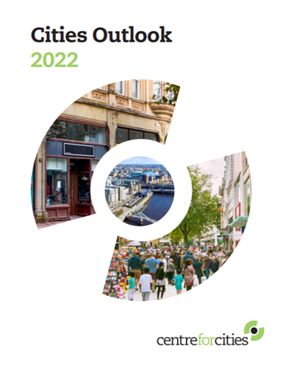
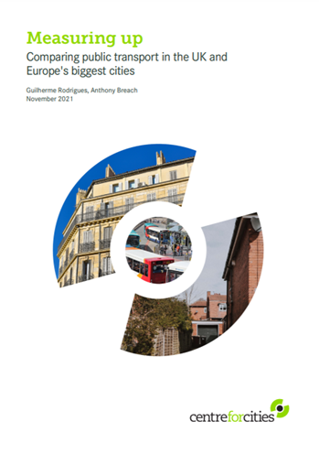
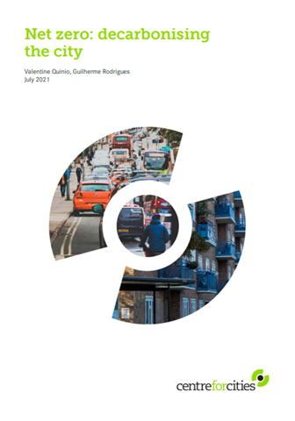
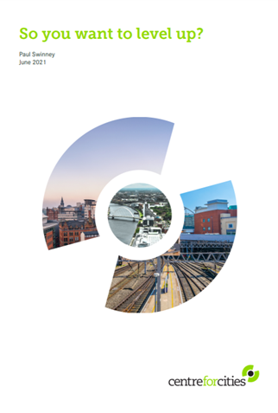
Who we are, what we do and overview of the presentation
Centre for Cities is a think tank whose core aim is to help improve the economic performance of the UK’s largest cities and towns, with research and advocacy work on a wide range of issues: transport, housing, devolution, skills, environment.
This presentation is based on a recent Cities Outlook 2022 publication looking at the impact Covid has had on UK city centres and high streets, as well as other pieces of work including our High Street Tracker
©2022 Leicestershire Business Voice | www.lbv.co.uk | @/LBVtweets

Slide 7
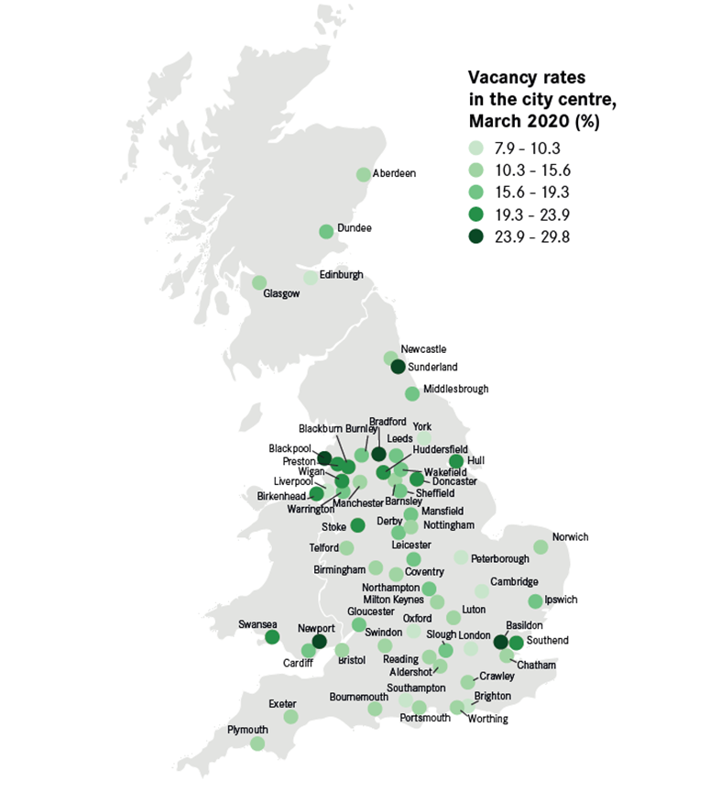
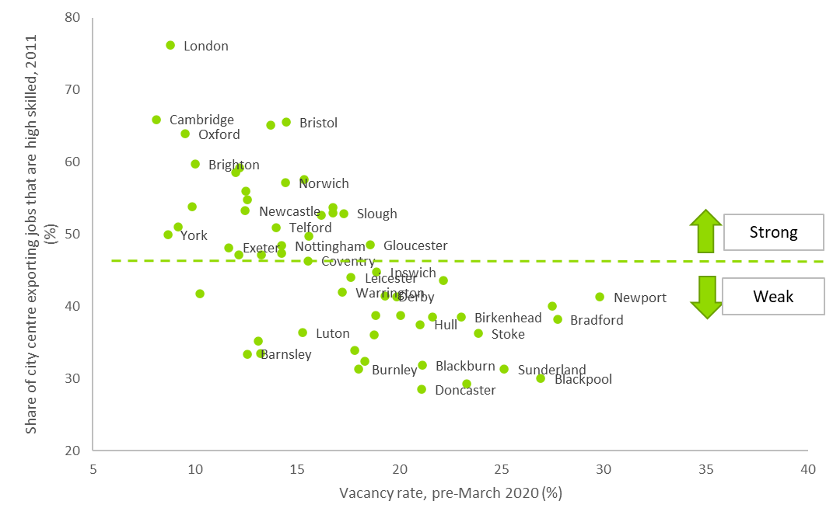

Understanding where we were pre-Covid: the performance of the high street was driven by the strength of the city centre economy
©2022 Leicestershire Business Voice | www.lbv.co.uk | @/LBVtweets

Slide 8
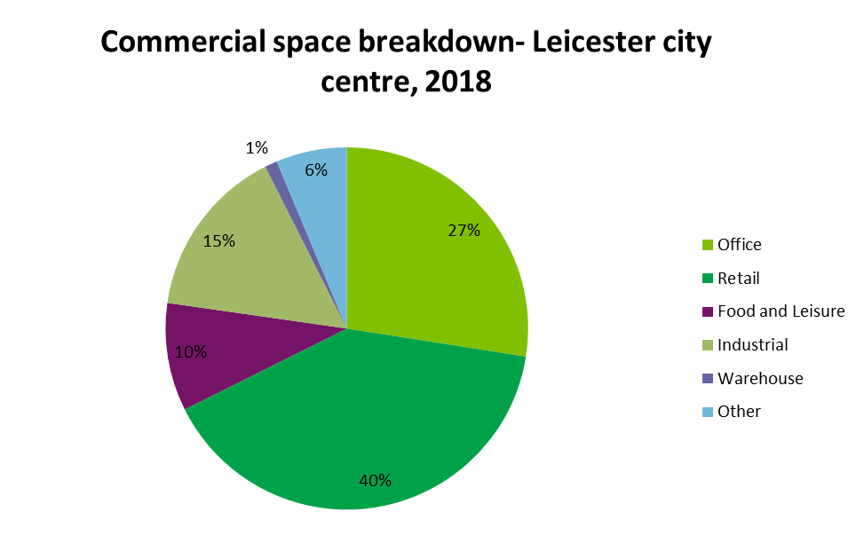
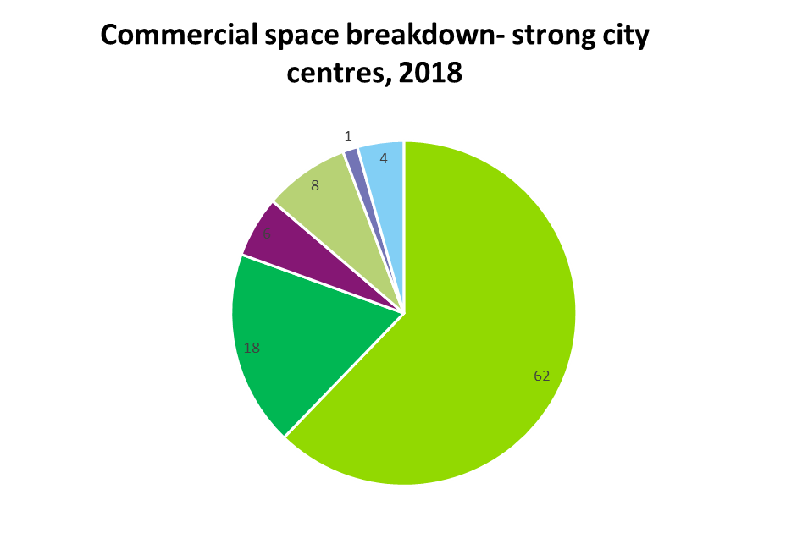
And this was also reflected in terms of commercial space and offer on the high street
Strong city centres have triple the amount of office space
Given the change retail has undergone in the past few years, this is unlikely to be an asset- unlike hospitality, which is more likely to perform well in the future
Share of industrial space: scope for re-purposing towards different uses?
©2022 Leicestershire Business Voice | www.lbv.co.uk | @/LBVtweets

Slide 9
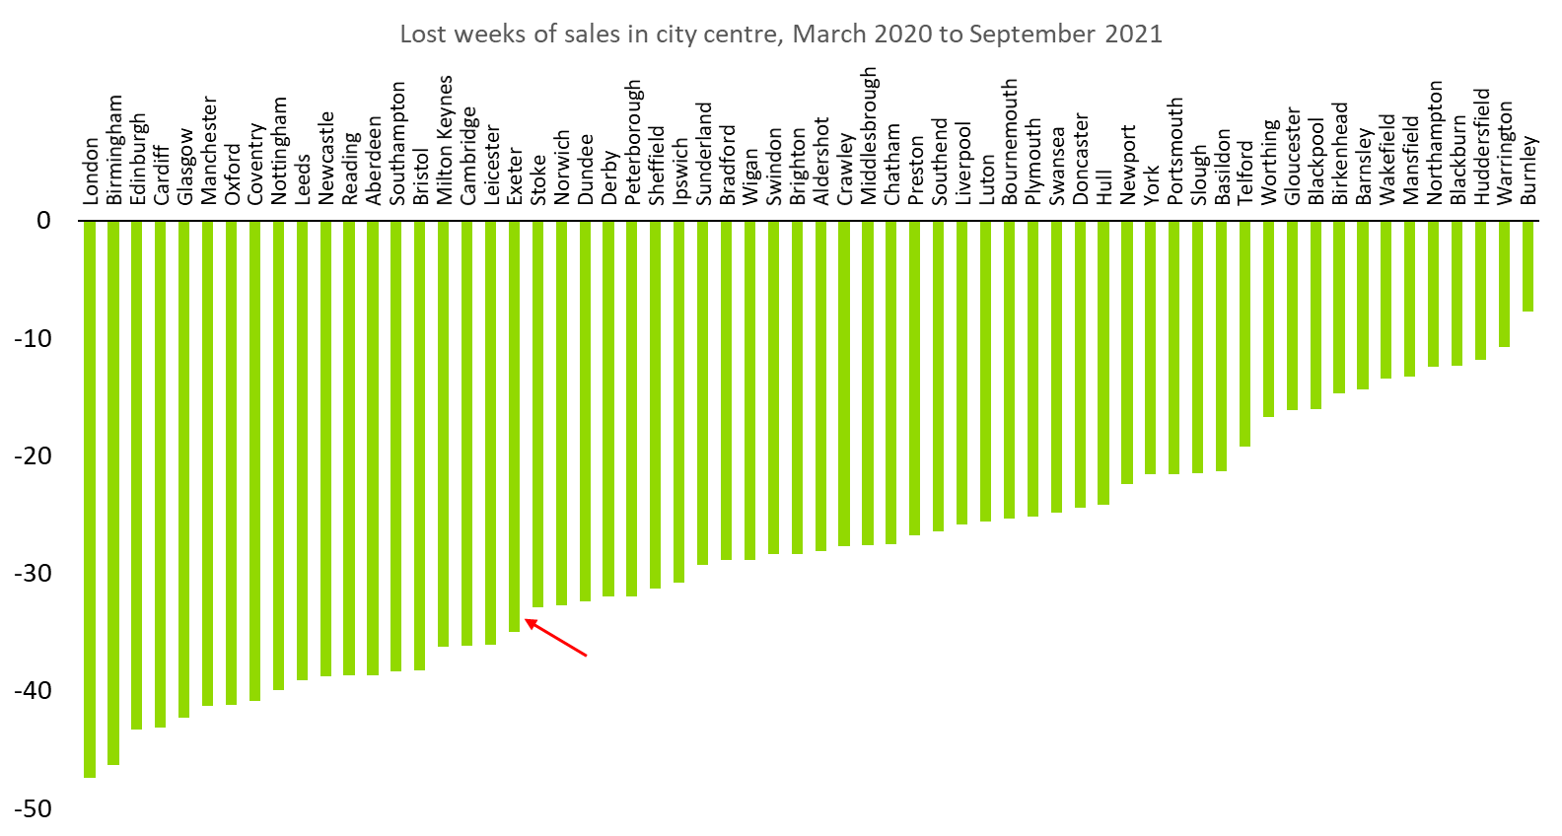
Impact of Covid on high street businesses: lost sales. Leicester was among the most impacted cities
©2022 Leicestershire Business Voice | www.lbv.co.uk | @/LBVtweets

Slide 10
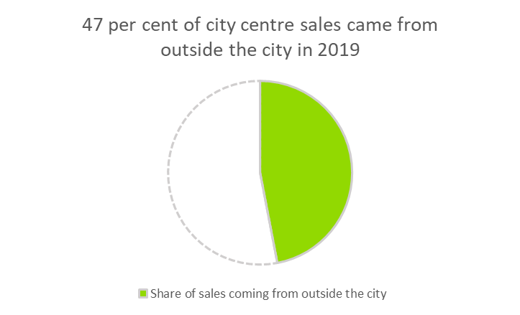
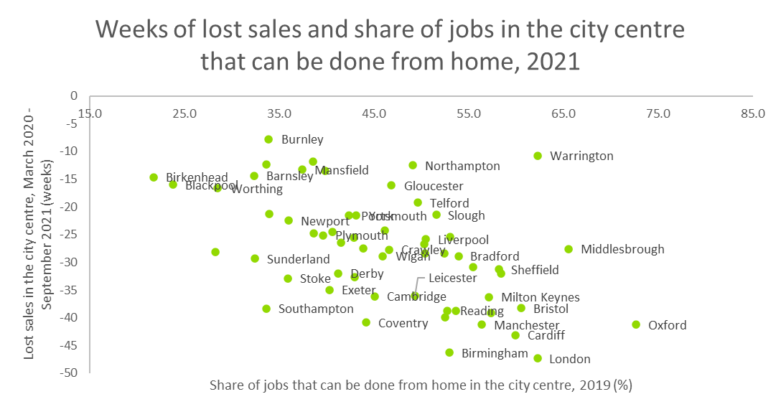
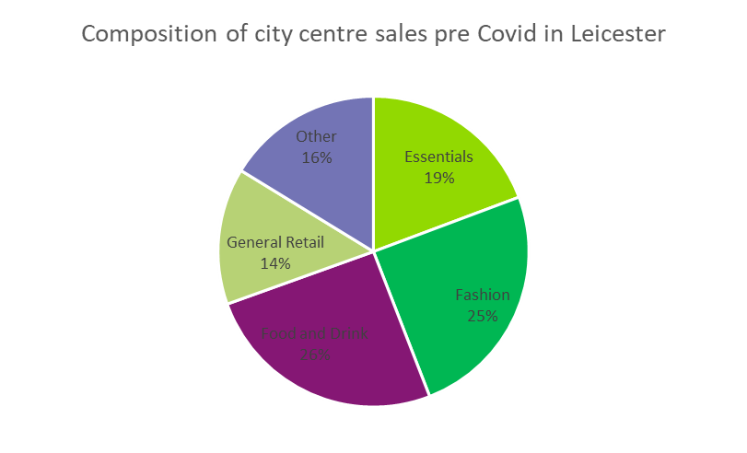
There are 3 main reasons for this: when strengths turn into weaknesses
A shrinking customer base as a result of travel restrictions
Shifts to remote working on an unprecedented scale
Composition of the offer on the high street and reliance on non-essentials like fashion and hospitality
1.
2.
3.
©2022 Leicestershire Business Voice | www.lbv.co.uk | @/LBVtweets

Slide 11
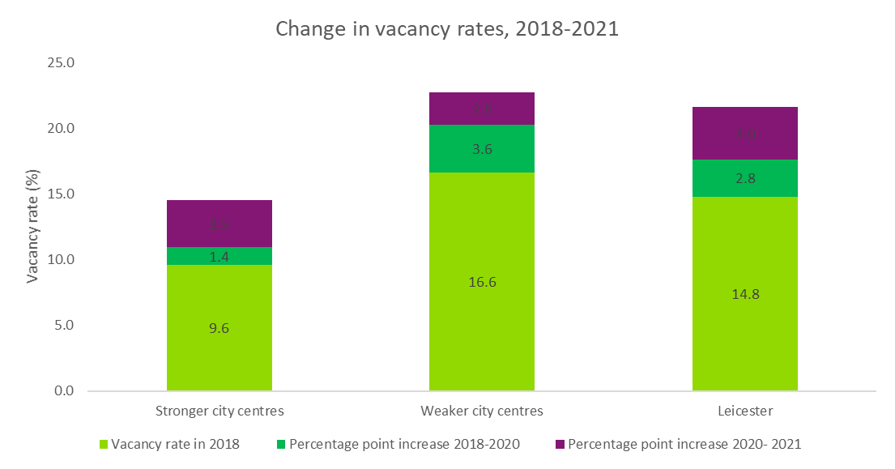
‘Real’ impact of Covid on high street businesses: vacancy rates
With 300+ vacant units on the high street, Leicester vacancy rate is about 21 per cent (September 2021)
This is close to the average for the ‘weaker cities’ group, but the ‘Covid effect’ was particularly strong
©2022 Leicestershire Business Voice | www.lbv.co.uk | @/LBVtweets

Slide 12
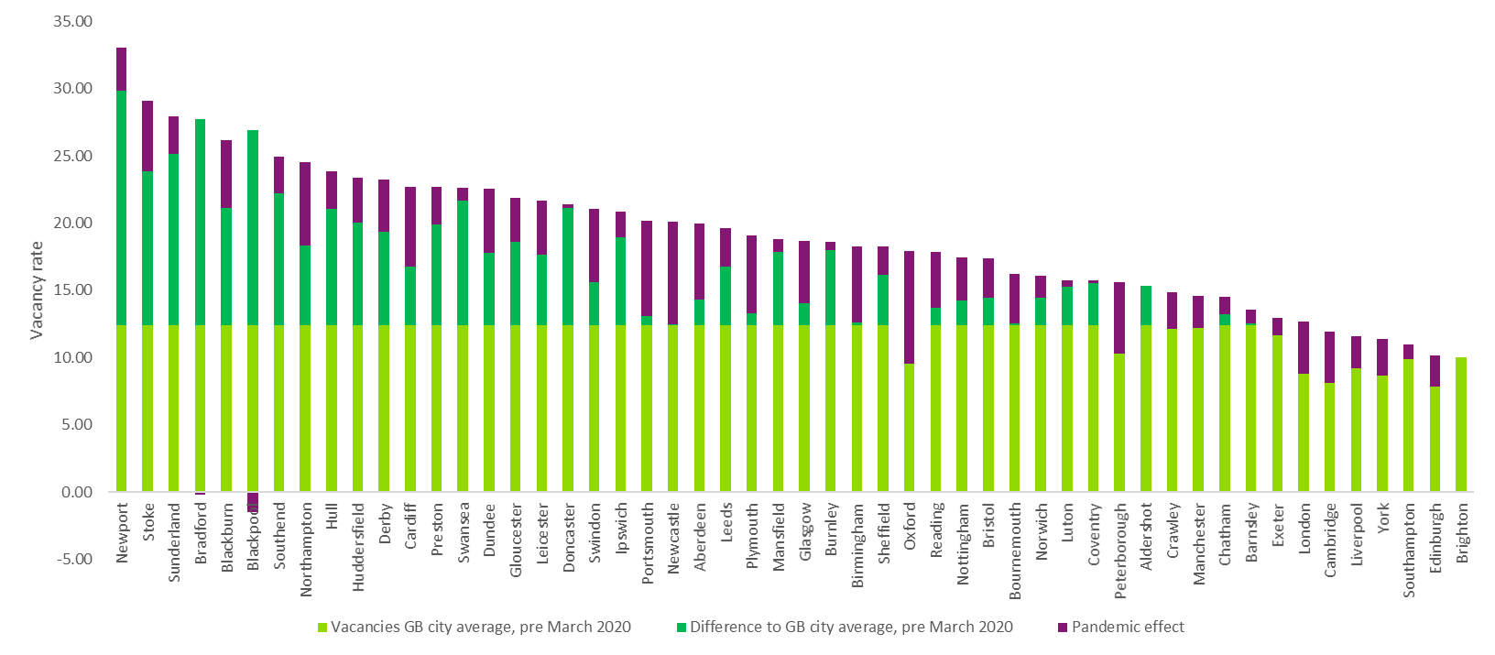

A quick look at how Leicester compares with other cities
©2022 Leicestershire Business Voice | www.lbv.co.uk | @/LBVtweets

Slide 13
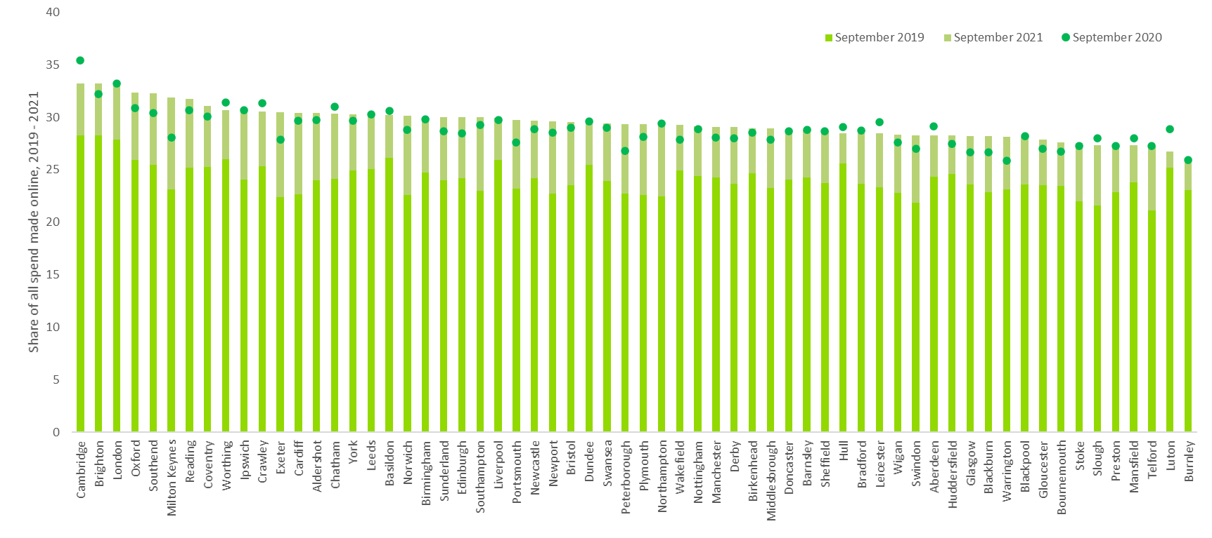
Looking at how our behaviours have changed also helps understand the impact of Covid, beyond the immediate short term: let’s look at online shopping
Before the pandemic, about 23 per cent of all spending was made online in Leicester. It is now 28 per cent, an increase broadly similar to what we’ve seen elsewhere.
But there is no relationship between online spending and vacancy rates on the high street
©2022 Leicestershire Business Voice | www.lbv.co.uk | @/LBVtweets

Slide 14
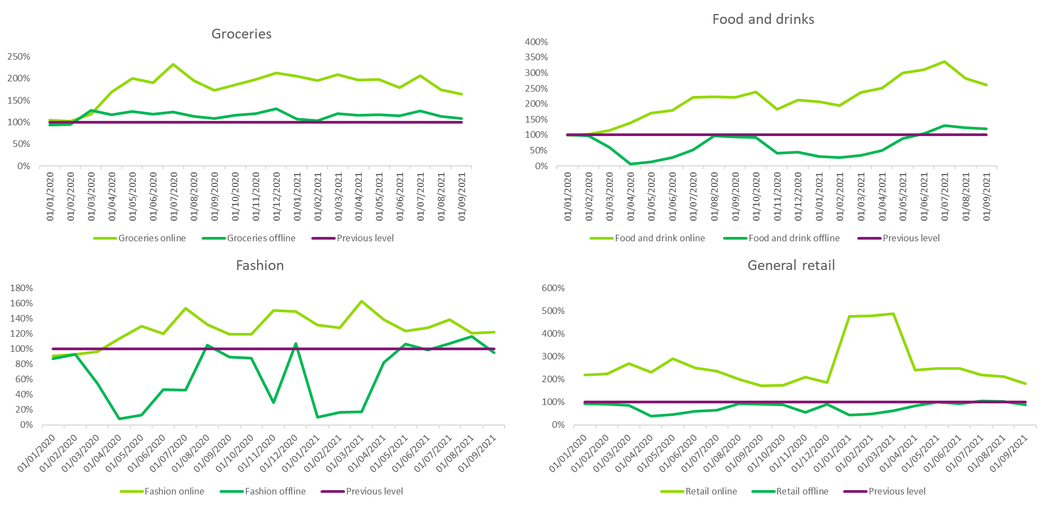
Is the rise in internet shopping a worrying trend? What does this mean for different sectors in Leicester, and for the future role of the city centre economy more generally?
©2022 Leicestershire Business Voice | www.lbv.co.uk | @/LBVtweets

Slide 15
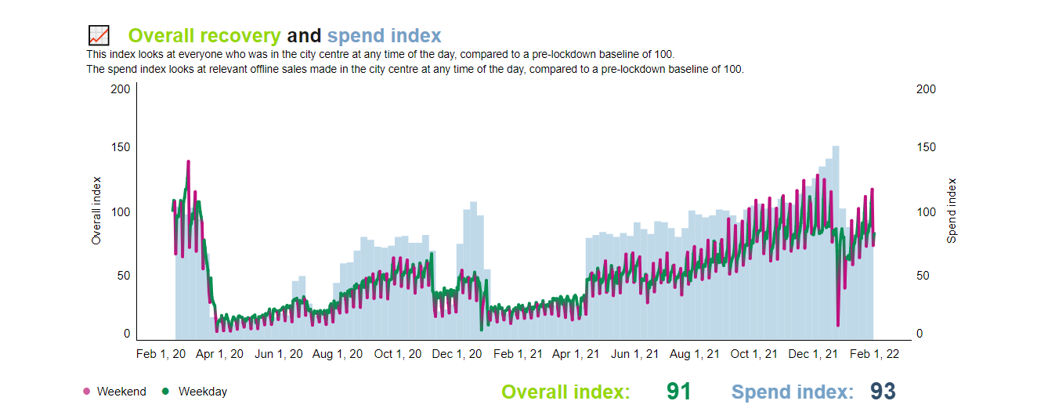
Where we are now? Clear path to recovery, but weekday footfall still lagging behind: are workers reluctant to return?
January 2022: | WEEKDAY RECOVERY | WEEKEND RECOVERY | NIGHT-TIME RECOVERY
Leicester | 85% | 100% | 107%
Average UK cities | 44% | 76% | 70%
©2022 Leicestershire Business Voice | www.lbv.co.uk | @/LBVtweets

Slide 16
Concluding thoughts: what does this all mean for the future?
The Covid-19 pandemic took a heavy toll on Leicester city centre, with a high number of lost weeks of sales translating into a number of vacant units on the high street- and we should expect to see the full impact once government support comes to an end.
The city centre now seems on a clear path to recovery, and this is good news- against claims that spending would shift online or to local centres, the city centre still plays a key role as a prime destination for shopping and leisure
But there are short term challenges (cost of living crisis) and long term ones: ‘recovery’ means bouncing back to an ‘underperforming’ position, with pre-pandemic challenges that still need to be addressed, in addition to those brought about by the pandemic.
©2022 Leicestershire Business Voice | www.lbv.co.uk | @/LBVtweets

Slide 17
Concluding thoughts: what does this all mean for the future?
The priorities now are:
Weathering the storm: attract workers and shoppers back, evaluate impact of changes made to the city centre during Covid (transport, planning) and make them permanent if successful
Adapt to changing nature of demand and changing role in the city centre economy, and build on existing strengths: towards the experience economy and less retail? Making the city centre a better place to live, work, study and play should be the focus.
Address the underlying economic fundamentals behind the lack of demand, and shift away from interventions which focus solely on physical design of the high street - what matters is to boost consumer spending power: investing in skills, office space, attracting productive, high-value jobs and build a stronger labour market pool.
©2022 Leicestershire Business Voice | www.lbv.co.uk | @/LBVtweets

Slide 18
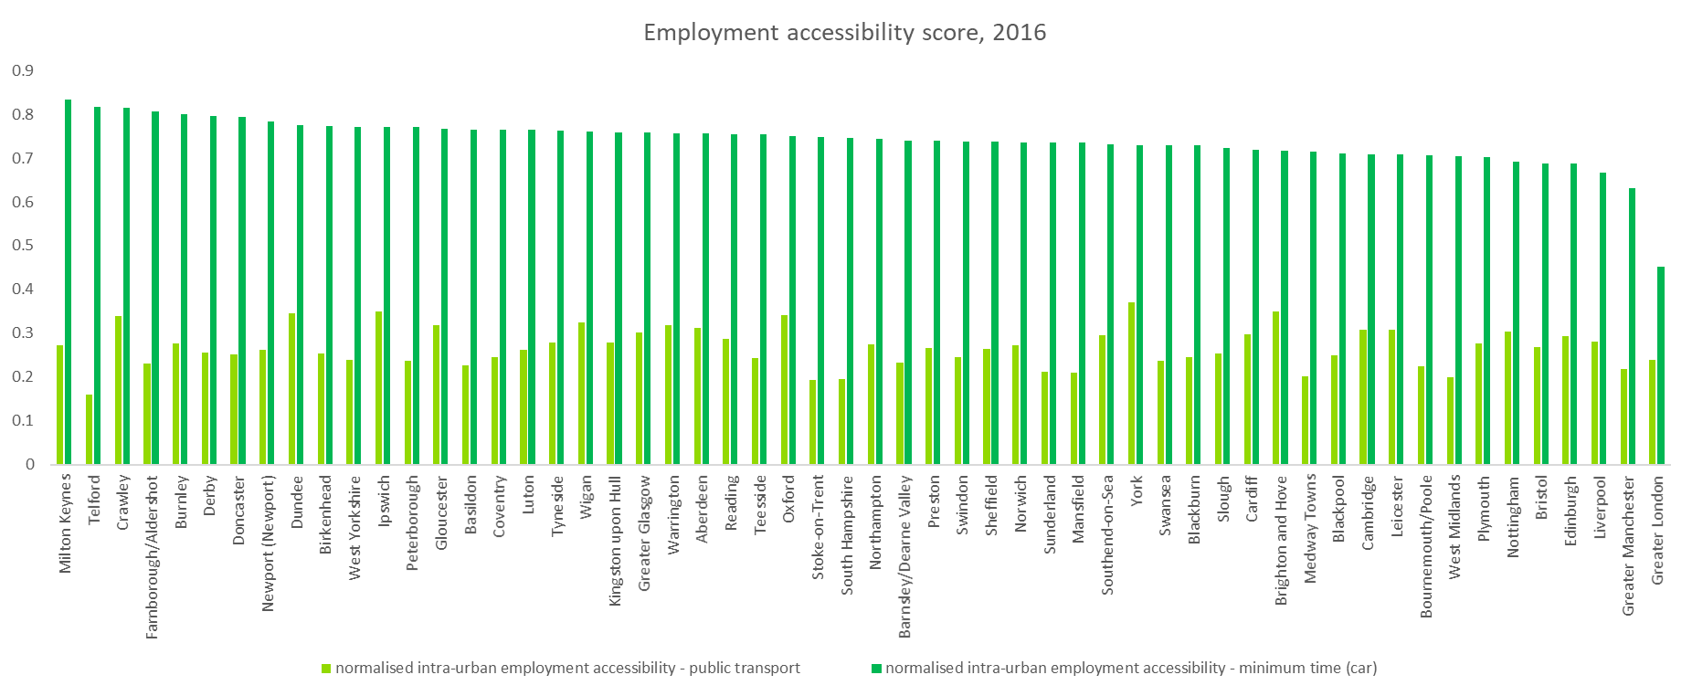

Annex 1: transport accessibility
Leicester is a dense and congested city
But it can also build on higher than average active travel (walking + cyling) uptake
©2022 Leicestershire Business Voice | www.lbv.co.uk | @/LBVtweets

Slide 19
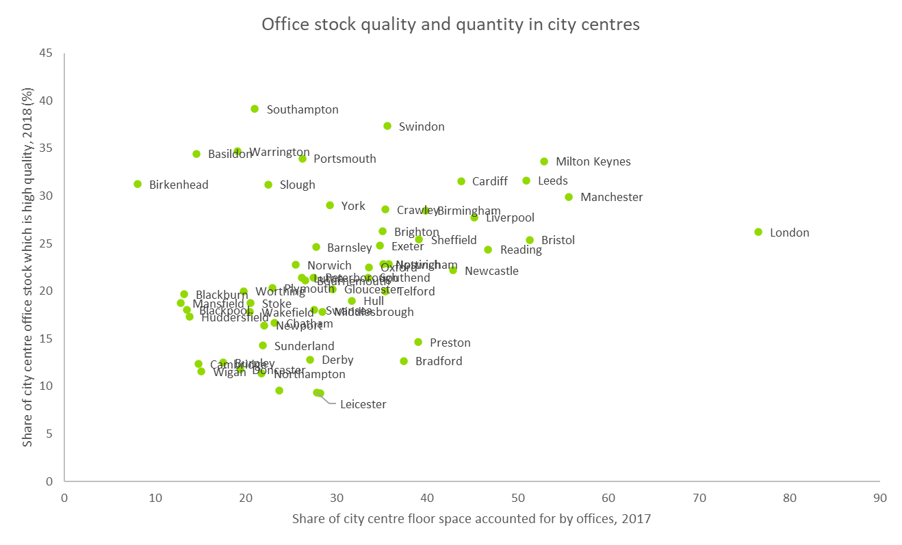
Annex 2: Office space offer in the city centre
©2022 Leicestershire Business Voice | www.lbv.co.uk | @/LBVtweets

Slide 20
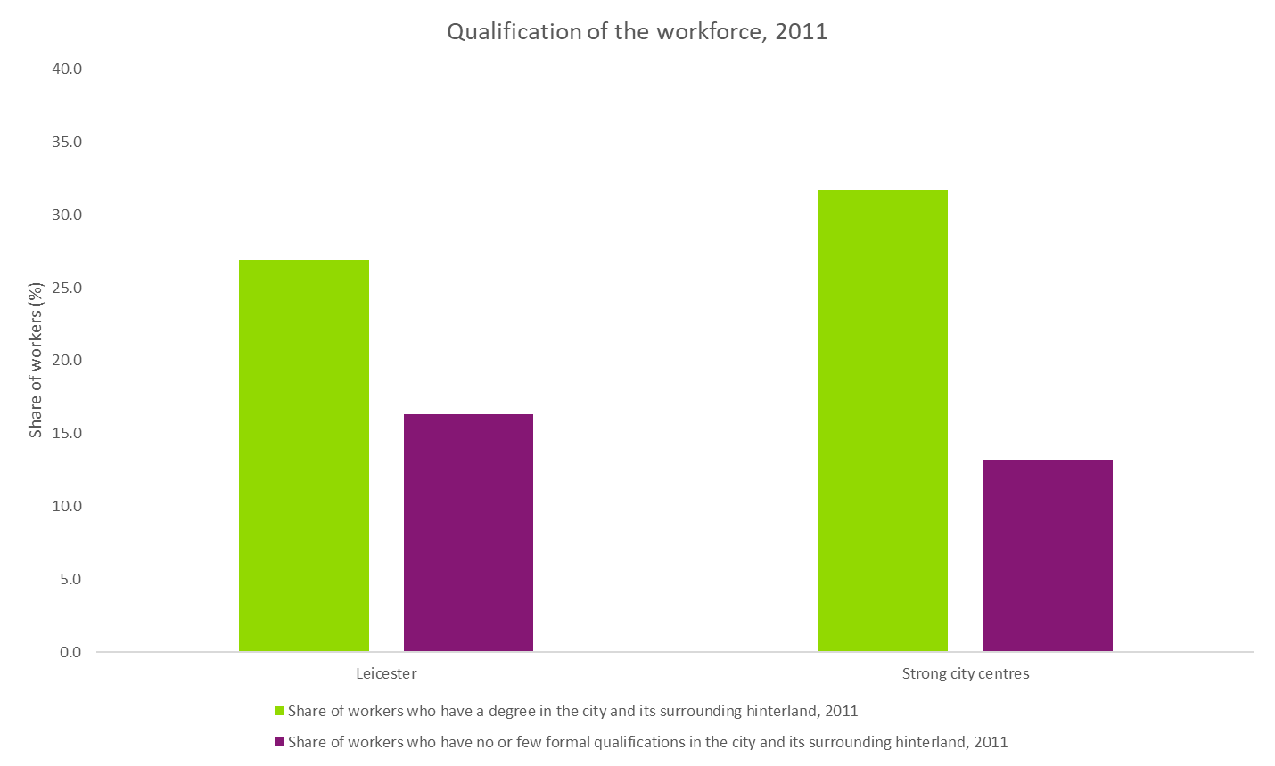
Annex 3: Skills of the workforce in the wider area
©2022 Leicestershire Business Voice | www.lbv.co.uk | @/LBVtweets

Slide 21
Panel discussion
The outlook for Leicester and how the city can
prosper in the future
©2022 Leicestershire Business Voice | www.lbv.co.uk | @/LBVtweets

Slide 22
Forthcoming events
5 May – Members’ Dinner, Leicestershire County Cricket Club with guest speaker, Nishan Canagarajah, President and Vice-Chancellor at the University of Leicester
3 June – Future of the City Centre Part 2, Netwalking (Networking walk)
Further updates will be published at www.lbv.co.uk/events
©2022 Leicestershire Business Voice | www.lbv.co.uk | @/LBVtweets

Slide 23

Team Leicester – MIPIM in France
14 March 2022
Championing inward investment into Leicester and environs and as a great place to do business
Partnership of public sector and private businesses
Find out more at www.teamleicester.uk
©2022 Leicestershire Business Voice | www.lbv.co.uk | @/LBVtweets

Slide 24
Lend us your voice…
If you enjoyed today’s event, and would like to find out about becoming a Leicestershire Business Voice member, please speak to a Board Director today, or visit our website at www.lbv.co.uk
By joining LBV, you can:
Help businesses thrive
Voice your opinions with local & regional decision makers
Influence policy affecting our economy
©2022 Leicestershire Business Voice | www.lbv.co.uk | @/LBVtweets

