Slide 1
Transport connectivity of Leicester
What are the challenges and opportunities facing the manufacturing sector in 2021 and beyond?
Greening our Local Economy
©2021 Leicestershire Business Voice | www.lbv.co.uk | @/LBVtweets

Slide 2
Welcome & Introduction
Iain McKenzie
LBV Director and Chief Operating Officer at Mattioli Woods
©2020 Leicestershire Business Voice | www.lbv.co.uk | @LBVtweets

Slide 3
Our Speakers
Mary-Louise Harrison, Senior Projects Manager, LLEP
Gavin Fletcher, Midlands Energy Hub
Sam Lux, Department for Business, Energy and Industrial Strategy (BEIS)
Fiona Mahon, Climate Change Manager, Leicester City Council
Richard Garner, Head of Partnerships at Zellar

Slide 4
Mary-Louise Harrison
Senior Projects Manager,
LLEP
©2020 Leicestershire Business Voice | www.lbv.co.uk | @LBVtweets

Slide 5


COP26
MARY-LOUISE HARRISON
LEICESTER & LEICESTERSHIRE ENTERPRISE PARTNERSHIP
LEICESTER BUSINESS VOICE
29th October 2021
Notes:
GOOD MORNING EVERYONE
AS SENIOR PROJECTS MANAGER AT THE LEICESTER & LEICESTERSHIRE ENTERPRISE PARTNERSHIP OR LLEP FOR SHORT, WITH OVERALL RESPONSIBILITY FOR THE CARBON AGENDA, I HAVE BEEN ASKED HERE TODAY TO COME AND TELL YOU A LITTLE BIT ABOUT COP26
OR TO GIVE IT IT’S OFFICAL NAME - CONFERENCE OF THE PARTIES OR “COP” FOR SHORT
WHICH IS ABOUT TO KICK-OFF IN GLASGOW, IN 2 DAYS TIME
BUT WHY COP26 – THIS IS SIMPLY BECAUSE IT WILL BE THE 26TH TIME IN WHICH IT WILL MEET

Slide 6



COP26: WHAT IS IT?
United Nations Framework Convention on Climate Change or “COP26” for short
26 simply refers to the fact that this is 26th time they will have met
31st October – 12TH November 2021
Hosted by the UK in partnership with Italy it will take place in Glasgow’s Science Centre
Over 200 Heads of State will attend, plus hundreds of climate experts and campaigners
Notes:
WHAT EXACTLY IS COP26 AND WHY IS IT GIVEN SO MUCH IMPORTANCE?
IT IS THE United Nations climate summit where world leaders COME TOGETHER TO DISCUSS AND co-ordinate action to stop the rise in global temperatures AND REVERSE CLIMATE CHANGE.
OVER THE 2 WEEKS, 30,000 PEOPLE ARE EXPECTED TO BE IN GLASGOW
it will bring together over 200 Heads of State, climate experts and campaigners TO DISCUSS CLIMATE CHANGE AND WHAT NEEDS TO BE DONE TO TRY AND HALT GLOBAL WARMING AND OVER TIME REVERSE IT

Slide 7

COP26 - IT’S PURPOSE?
To agree and co-ordinate actions to tackle climate change
Reduce carbon emissions
Our climate has no borders
What happens in one part of the world, affects everyone
Notes:
GLOBAL TEMERATURES ARE RISING AND IT AFFECTS US ALL
THE AMOUNT OF CO2 IN THE EARTH’S ATMOSPHERE IS RISING AND IS NOW FAR HIGHER THAN AT ANY POINT THAN IN THE LAST 400,000 YEARS.
AND IT IS STILL RISING!
THE DISCUSSIONS BETWEEN WORLD LEADERS ISN’T ABOUT WHETHER OR NOT CLIMATE CHANGE NEEDS AND GLOBAL WARMING TO BE ADDRESSED.
BUT BY HOW MUCH AND BY WHEN BEFORE IT BECOMES IRREVERSIBLE.

Slide 8
COP26: WHY IS IT IMPORTANT?
An opportunity for the world to see what has been achieved in meeting the targets agreed at Paris
Pay attention to what hasn’t
Hold Governments to account
Further drive the need for everyone to “play their part”
Anticipated to be the most important “COP” since 2015 in which the now famous “Paris Agreement” was signed. But will it be?
Notes:
Presidents and prime ministers will report on how their countries have progressed AGAINST THE TARGETS THEY SET THEMSELVES AT COP21 KNOWN AS “THE PARIS AGREEMENT”
AND MORE IMPORTANTLY, AGREE NEW ONES.
It IS BEING HELD of course, against the backdrop of the COVID-19 pandemic, which brought economies around the world to a standstill.
But instead of diverting attention AWAY from THE DEVASTATION OF climate change and sustainability, the pandemic has ACTUALLY done something surprising.
INDIVIDUALS, COMMUNITIES AND BUSINESSES LIKE YOURSELVES ARE BEGINNING TO BECOME BETTER ENGAGED AND UNDERSTAND THE ISSUES FOR YOURSELVES AND ARE NO LONGER WAITING FOR GOVERNMENTS TO ACT FIRST

Slide 9
COP26: WHAT WE CAN EXPECT
We can expect a flurry of new announcements
Many are expected to be very technical - including rules still needed to implement the Paris Agreement
Other announcements could include:
  Making a faster switch to electric cars
  Speeding up the phasing out of coal power
  Cutting down fewer trees
  Protecting more people from the impacts of climate change, such as funding coastal-defence systems
Notes:
FOR EXAMPLE, IN A DELIBERATE MOVE INTENDED TO INFLUENCE WORLD LEADER’S, CEMENT MAKERS AROUND THE WORLD HAVE PLEDGED TO CUT THEIR EMMISIONS BY UP TO 25% THIS DECADE, REACHING NET ZERO BY 2050
WHY WILL THIS MAKE A DIFERENCE TO COP26?
BECAUSE THE CEMENT INDUSTRY IS RESPONSIBLE FOR NEARLY 8% OF ALL GLOBAL CARBON DIOXIDE EMISSIONS. NO INDIVIDUAL COUNTRY PRODUCES THIS AMOUNT OF CO2 OTHER THAN THE UNITED STATES AND CHINA.
THIS PLEDGE, IF REALISED, WILL STOP 5 BILLION TONNES OF CO2 BEING RLEASED INTO THE ATMOSPHERE. THEY INTEND TO ACHIEVE THIS BY CHANGING THE CHEMICAL PROCESSES AND MATERIALS THEY USE AS WELL AS BECOMING MORE ENERGY EFFICIENT.
THE SIGNIFICANCE OF THIS DECLARATION, IS THAT IT MARKS THE FIRST TIME THAT MAJOR PRODUCERS AROUND THE GLOBE HAVE MADE A PUBLIC COMMITMENT TO REDUCE THEIR IMPACT AND ADDRESS CLIMATE CHANGE INDEPENDENT OF GOVERNMENTS
BUT THEY STILL NEED GOVERNMENT INTERVENTIONS, SUCH AS THE MEANS BY WHICH TO CAPTURE CARBON AND THEN STORE IT, IF THEY ARE TO DE-CARBONISE FURTHER AND IT IS THIS INTER-FACE BETWEEN GOVERNMENTS, BUSINESS AND PEOPLE THAT WILL PLAY OUT IN COP26

Slide 10
COP26: HERE IN THE UK
In April 2021 the UK Government legislated to reduce carbon emissions by 78% by 2035 compared to 1990 levels; And become net zero by 2050
UK still largely dependent on imported gas due to unpredictability of wind and solar
For the first time in 2020, wind and solar produced a record 43% of our electricity compared to 40% provided by fossil fuels
UK Government’s long awaited Net Zero Strategy published
Notes:
IN APRIL, THE GOVERNMENT LEGISLATED TO REDUCE CARBON EMMISIONS IN THE UK BY 78% BY 2035, AND BE CARBON NEUTRAL BY 2050. THESE ARE IN LINE WITH TARGETS SET BY THE UNITED STATES.
LAST WEEK IT PUBLISHED ITS “NET ZERO STRATEGY” SETTING OUT HOW IT INTENDS TO MEET THESE AMBITIOUS TARGETS.
AT IT’S CORE IS AN AMBITION FOR A FULL DE-CARBONISED POWER SECTOR BY 2035, WITH ELECTRIFICATION, SUPPORTED BY LOW-CARBON HYDROGEN, LEADING TO A PHASE-OUT OF FOSSIL FUELS FROM SURFACE TRANSPORT, HOME HEATING AND MUCH OF INDUSTRY BEGINNING WITHOUT DELAY.
WHILST IT IS ACKNOWLEDGED THAT A LARGE FINANCIAL BILL WILL COME WITH THIS,
IT WILL IN FACT, GENERATE ALMOST ONE TRILLION POUNDS WORTH OF SAVINGS.
THE MAJORITY OF WHICH WILL BE SECURED BY BUSINESSES AND HOUSEHOLDS RATHER THAN THE TREASURY

Slide 11
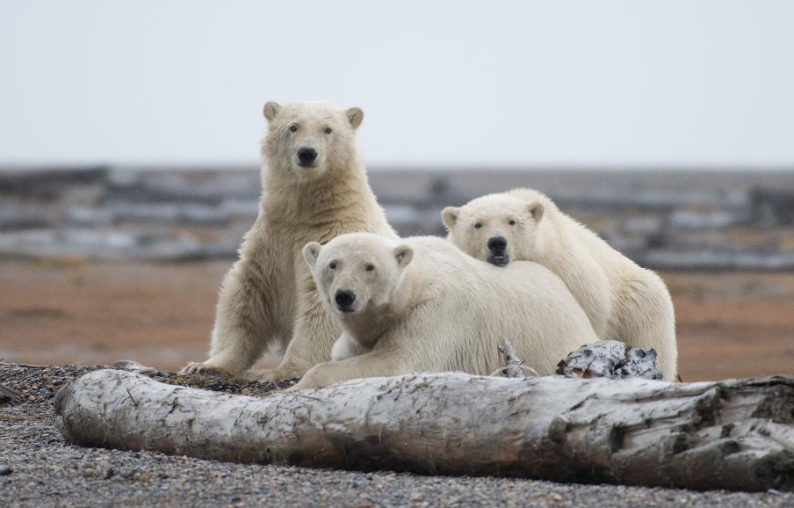
Thank you for Listening
Any Questions?
Mary-Louise Harrison
mary-louise.harrison@llep.org.uk
0116 454 2944
Notes:
FINALLY, I WANT TO LEAVE YOU WITH A PHOTO OF SOME BEAUTIFUL MAJESTIC POLAR BEARS
THE SIGNIFICANCE?
BECAUSE IF WE DON’T DO SOMETHING NOW, AND GLOBAL WARMING CONTINUES TO RISE, IT IS CREATURES LIKE THIS WHO, UNABLE TO ADAPT QUICK ENOUGH, WILL FEEL IT FIRST AND WILL ALONG WITH THEIR HABITAT, DISAPPEAR ALTOGETHER.
HOWEVER, UNLIKE THEM, WE CAN HELP THEM AND OURSELVES BY MAKING THE NECESSARY CHANGES NEEDED
WE CAN REDUCE OUR RELIANCE ON FOSSIL FUELS, CHANGE OUR ECONOMIES TO BECOME GREENER, HEALTHIER AND MORE SUSTAINABLE AND START TO REVERSE GLOBAL WARMING.
THANK YOU

Slide 12
Gavin Fletcher
Regional Senior Energy Projects Officer, MEH and LLEP
©2020 Leicestershire Business Voice | www.lbv.co.uk | @LBVtweets

Slide 13





Leicester Business Voice presentation
Gavin Fletcher – Regional Senior Energy Projects Officer
– MEH and LLEP

Slide 14




Carbon Reduction, Energy and Sustainability supports organisations to switch to renewable and low carbon energy solutions
customerservices@energyservices-ncc.gov.uk | 0115 955 6677 | www.energyservices-ncc.co.uk

Slide 15
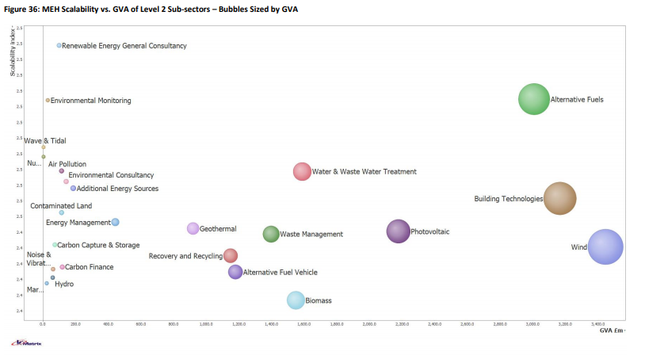
Low Carbon and Environmental Goods and Service Sector
MEH’s Low Carbon and Environmental Goods
and Services (LCEGS) sector is worth £26.6bn. The five largest sub-sectors in the LCEGS sector by sales account for 64% of the MEH’s total sales and are made up of:
Wind (£4.4bn)
Building Technologies (£4.0bn)
Alternative Fuels (£3.8bn)
Photovoltaic (£2.8bn)
Water & Waste Water Treatment (£2.0bn)
Report available from: https://www.sustainabilitywestmidlands.org.uk/resources/midlands-low-carbon-sector-study/
Carbon Reduction, Energy and Sustainability supports organisations to switch to renewable and low carbon energy solutions
customerservices@energyservices-ncc.gov.uk | 0115 955 6677 | www.energyservices-ncc.co.uk

Slide 16
Low Carbon Transport Hub study
Midlands Energy Hub supported Coventry City Council and Cenex to produce a report mapping out potential sites across the Midlands for Low Carbon Transport Hubs:
https://www.energyservices-ncc.co.uk/uploads/documents/Midlands-Regional-Transport-Hubs-Final-Report.pdf
This, report along side the LCEGSS Report clearly lays out the huge potential of the Midlands in low carbon transport and alternate fuels
  Alternative Fuels contributes £3.8bn – this includes R&D functions, alternative fuel providers, designers and consultancy, process implementation, sales and accounting and application development specialists
  Alternative Fuel Vehicle contributes £1.5bn - include selling agencies, alternative fuel development companies and consulting and applications development for vehicle conversion specialists
  Furthermore, Alternate Fuel Vehicles saw stronger growth in the Midlands than the UK average between 2017/18 and 2019/20 at 11.4% compared to the UKs 5.7%
Carbon Reduction, Energy and Sustainability supports organisations to switch to renewable and low carbon energy solutions
customerservices@energyservices-ncc.gov.uk | 0115 955 6677 | www.energyservices-ncc.co.uk

Slide 17
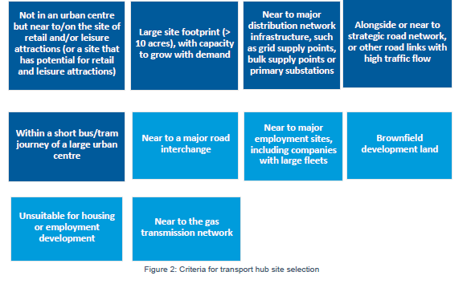


Low Carbon Transport Hubs
The required criteria (dark blue) reflect the prior work completed for CCC.
The ideal criteria (lighter blue) allowed for some diversity between the sites. Although not critical, the work for CCC identified that these are important nonetheless.
50 sites identified across the Midlands
Next step – identify funding to develop feasibility and business case.
Energy Services & Midlands Energy Hub supports organisations to switch to renewable and low carbon energy solutions
customerservices@energyservices-ncc.gov.uk | 0115 955 6677 | www.energyservices-ncc.co.uk

Slide 18

H2GVMids
Energy Services & Midlands Energy Hub supports organisations to switch to renewable and low carbon energy solutions
customerservices@energyservices-ncc.gov.uk | 0115 955 6677 | www.energyservices-ncc.co.uk

Slide 19
Thank you
Any questions?
For further information please contact:
Gavin.Fletcher@nottinghamcity.gov.uk
07516110212
Carbon Reduction, Energy and Sustainability supports organisations to switch to renewable and low carbon energy solutions
customerservices@energyservices-ncc.gov.uk | 0115 955 6677 | www.energyservices-ncc.co.uk

Slide 20
Sam Lux
Department for Business, Energy and Industrial Strategy (BEIS)
©2020 Leicestershire Business Voice | www.lbv.co.uk | @LBVtweets

Slide 21
Together for our Planet Business Climate Leaders Campaign

Slide 22
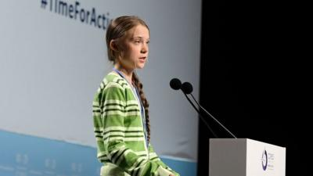
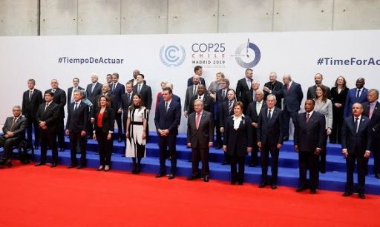
What is COP26?
Short for the 26th United Nations ‘Climate Change Conference of the Parties’.
Annual summit where heads of state, climate experts, and specialist negotiators come together to agree coordinated action to tackle climate change.
Hosted in Glasgow 1st-12th November 2021
Largest summit the UK has ever hosted, with over 30,000 delegates
Notes:
Later this year in November, the UK will host the world’s largest climate change conference, known as COP26.
It is set to be the largest summit the UK has ever hosted, with more than 30,000 delegates attending in Glasgow from 1st-12th November.
COP26 is widely seen as crucial if climate change is to be brought under control. Here world leaders will discuss whether enough has been achieved since 2015's landmark Paris climate agreement.

Slide 23
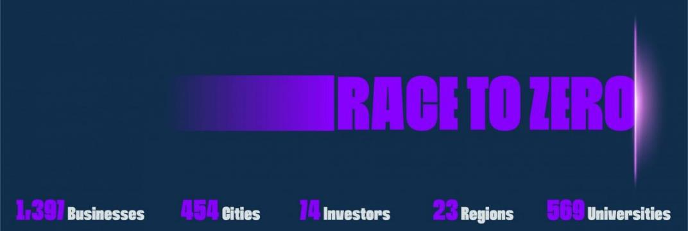

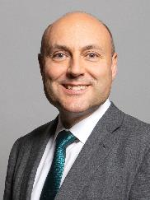
UN Campaign
Largest ever alliance committed to net zero by 2050 at the latest
UK Campaign
Net Zero public engagement
Net Zero business engagement
Andrew Griffith MP
Net Zero Business Champion
Notes:
Race To Zero is the United Nation’s major global campaign to rally leadership and support from businesses, cities, regions and investors. The objective is to create a healthy, resilient, zero carbon recovery that prevents future threats, creates decent jobs, and unlocks inclusive, sustainable growth.
It mobilizes a coalition of leading net zero initiatives, representing 733 cities, 31 regions, 3,067 businesses, 173 of the biggest investors, and 622 Higher Education Institutions. These ‘real economy’ actors join 120 countries in the largest ever alliance committed to achieving net zero carbon emissions by 2050 at the latest.
The UK has its own national campaign called Together for Our Planet in the lead up to COP26, which includes both public engagement and business engagement. The business engagement side is driven by Andrew Griffiths MP, the UK’s net zero business champion, and includes this Business Climate Leaders Campaign.

Slide 24



Why SMEs?
Business & industry = 25% UK emissions
SMEs:
99% of our 5.87 million enterprises
16.6 million employees (60%)
£2.2 trillion of revenue (52%)
Just under half of UK business emissions
Cannot ignore SMEs: whole systems approach
Notes:
Business and industry accounts for 25% of UK territorial emissions​
SMEs comprise more than 99% of the UK’s 5.87 million enterprises, 16.6 million employees (60% of the UK workforce) and generate £2.2 trillion of revenue (52% of the UK’s total)
SMEs comprise 99.9% of UK businesses and account for just under half of emissions within the sector, and so must be a focus for action​
We cannot ignore the contribution of SMEs to UK emissions. This is consistent with taking a "whole systems" approach to achieving Net Zero​

Slide 27

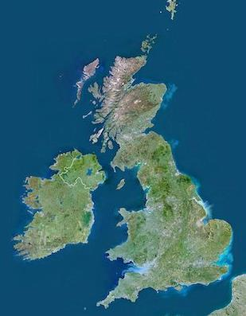



Campaign strands
Key ask of small businesses: Join the Race to Zero through UK digital platform on SME Climate Hub
National dissemination
UK landing page SME Climate Hub
Government channels
Net Zero taskforce - large corporations
Regional and DA events
Six virtual regional events
Sharing best practice across business, government & academia
Local & place-based
Local authorities & business networks
Sector-specific
Commit to electrifying your fleet by 2030 and investing in EV infrastructure by joining EV100
Commit to 100% ZEV production by 2040 or earlier.
Place-based engagement
Mobilising local communities, in partnership with individual networks & local authorities
Sector specialisation
SME working group shaping sector-specific support
Assimilating & signposting to existing plans and resources

Slide 28



















Campaign Supporters
Retail Sector Council

Slide 29
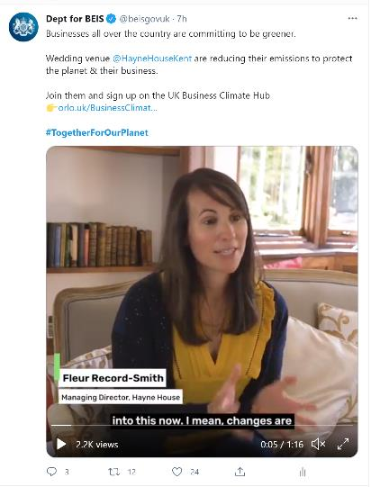
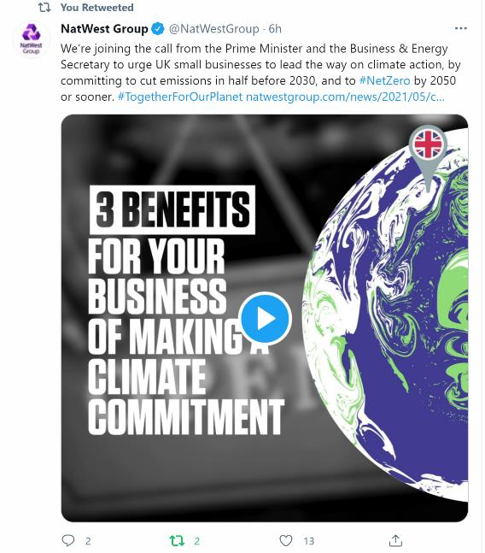
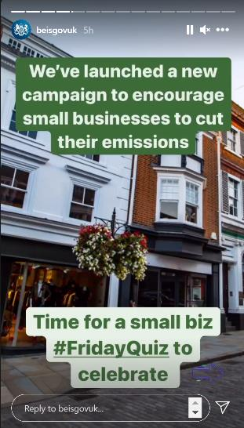
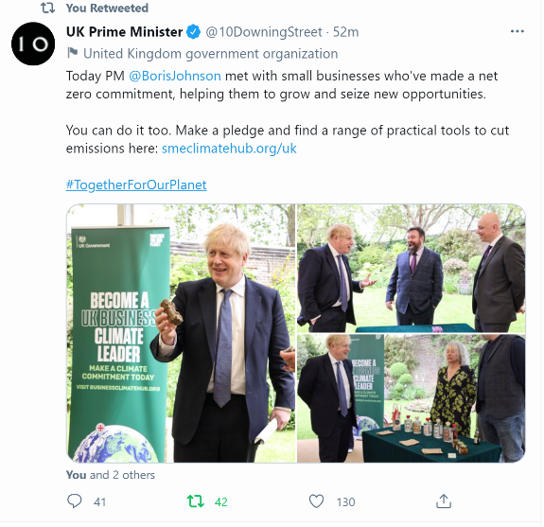
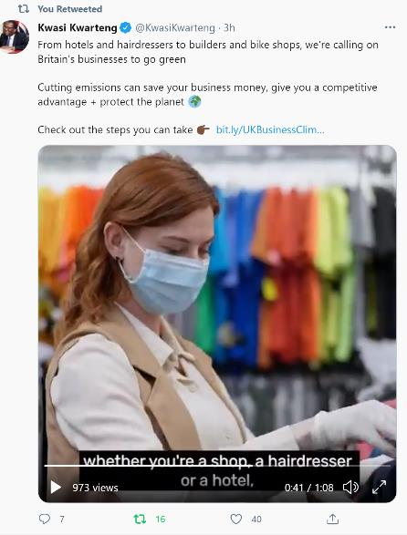
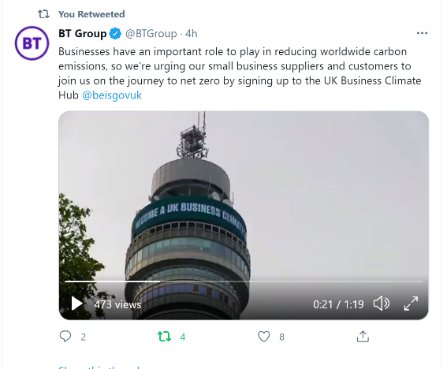
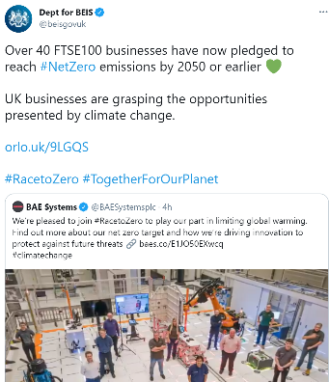

Launch & comms

Slide 30
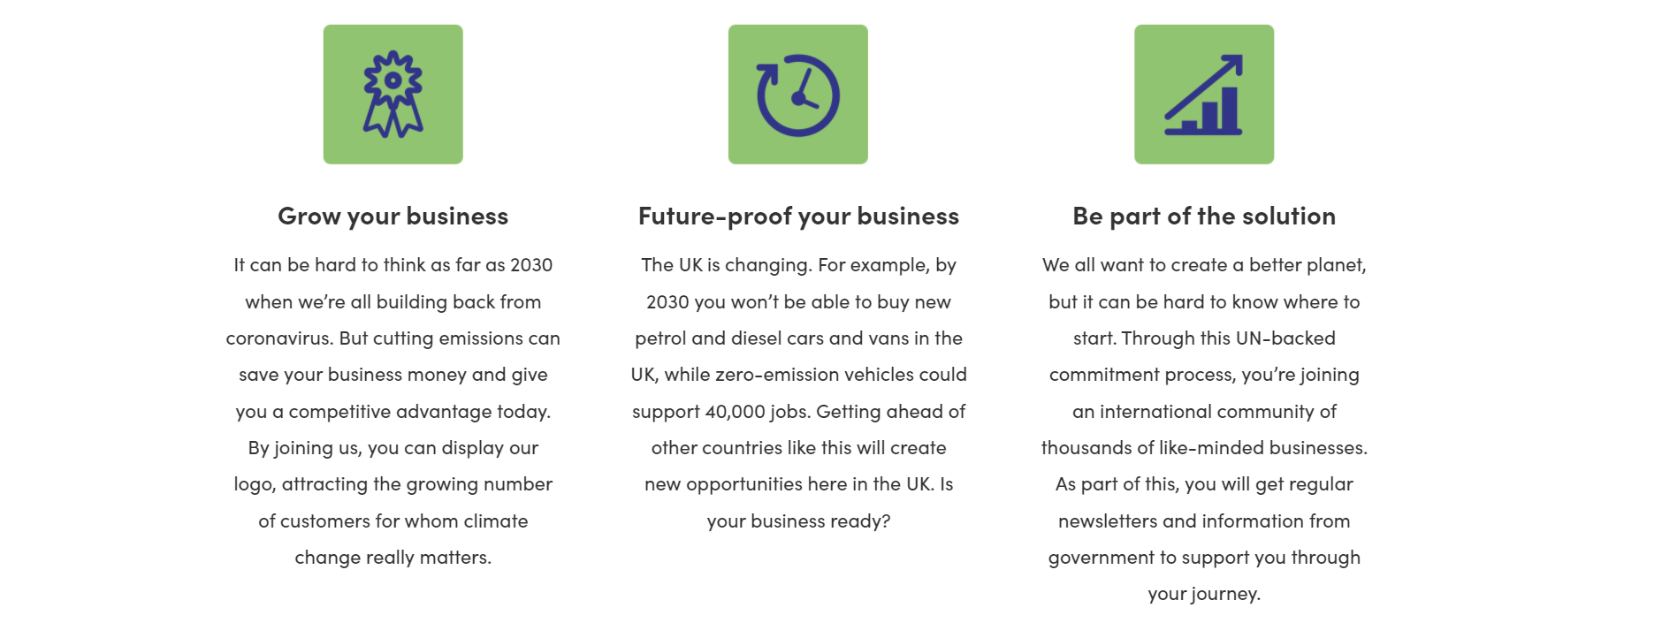
Top reasons to join the UN’s Race to Zero
30
Notes:
So why should your business be part of the Race to Zero?
Hopefully you now have a sense of the collective importance of climate action, but there are also many potential benefits for your business, such as:
Saving money through better resource efficiency
Attracting new customers who increasingly care about climate change and will choose where to shop accordingly
Becoming an earlier adopter and staying ahead of the curve so new regulation over the coming years and decades won’t be an issue

Slide 31
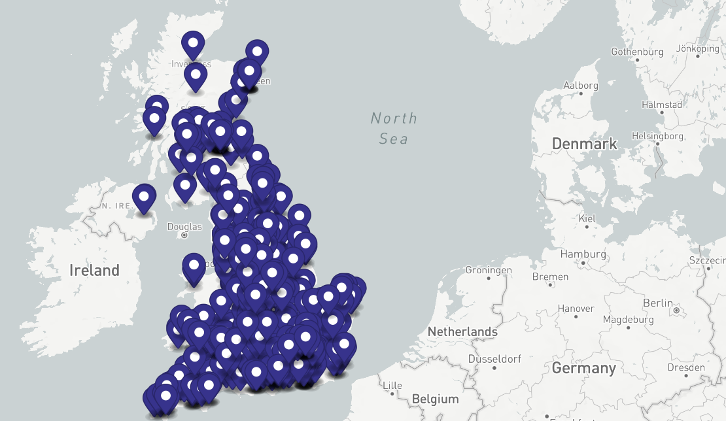
Gain recognition
Connect your work with global efforts
Pack of digital assets
Net zero date flexibility

Slide 32


How to join the Race to Zero
UNIVERSITIES
CITIES
SMALL BUSINESSES
Via SME Climate Commitment
REGIONS
LARGE BUSINESSES
INVESTORS
Notes:
It is very easy for you to join the Race to Zero.
There are different routes in for different kinds of organisation, but for small businesses and charity the way to join is by making the SME Climate Commitment.

Slide 33
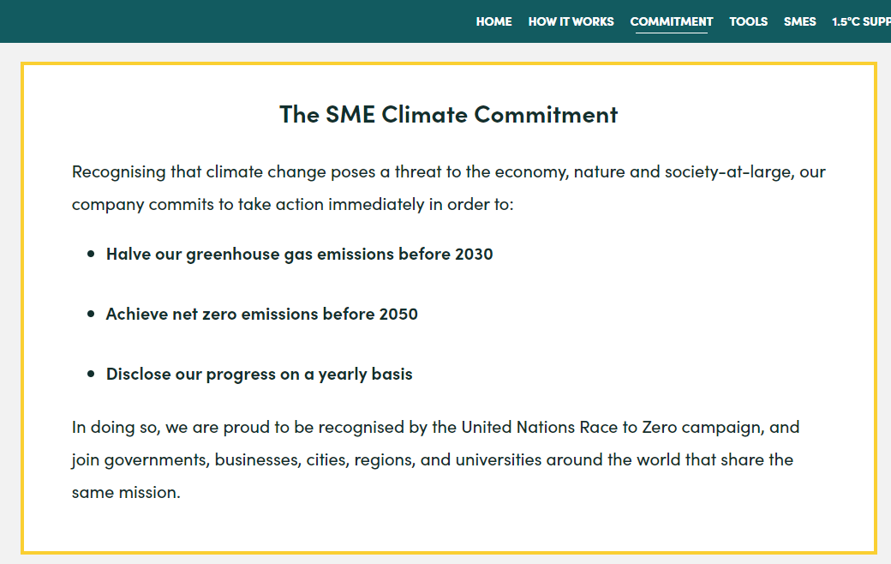
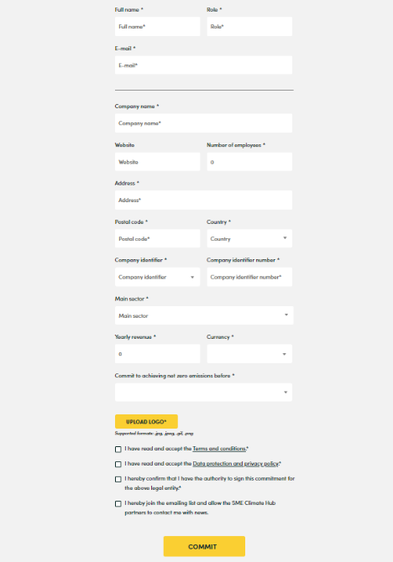
SME Climate Commitment
33
Notes:
All you have to do to make the SME Climate Commitment is fill in a short form with a few details about your business including a working email address. After signing up you will be recongised by the UN Race to Zero campaign, joining governments, businesses, cities, regions and universities around the world that share the same mission.
Making the SME Climate Commitment means your business is agreeing to start taking action to
Halve your greenhouse gas emissions by 2030
Reach net zero emissions by 2050
And submit your progress in a short template once a year

Slide 34


www.businessclimatehub.org/uk

Slide 35





What happens after signing up?
Access to resources to measure & reduce emissions
Receive a monthly newsletter with updates & opportunities (optional)
Chance for your story to feature in government channels & events
Start taking beneficial steps to cut emissions
Submit a short annual progress report
35
Notes:
Once you’ve signed up, you may be wondering what comes next. The answer is many things:
You will gain access to tools and advice on measuring and reducing your emissions
If you choose to opt in you’ll receive a monthly newsletter with latest updates on net zero policy changes and opportunities for your business
It’s possible that, with your agreement, your business might be featured in events and posts from the Government to help inspire and inform other businesses trying to reduce their emissions
On your side, hopefully you will feel you have enough knowledge to start making changes to reduce your emissions
Once a year you will be asked to submit an update on your progress to the SME Climate Hub, which will help them keep track of collective change and develop the kind of support available

Slide 36
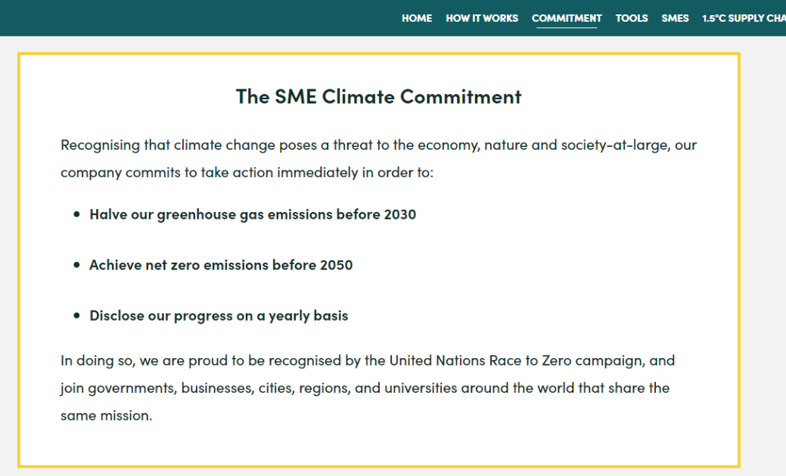
Yearly progress report
SME Climate Hub will provide you with key tools for tracking progress
They are working to streamline and simplify the reporting process for small businesses.
A new standard format for reporting is expected to be provided in late 2021.
Notes:
The SME Climate Hub is currently working on a new easy reporting template so that all businesses can provide their updates in a quick and standardised way.
This new template should become available in at the end of 2021.

Slide 37
Developing a new SME area
New internal view of the SME Climate Hub…
BUSINESS PROFILE
Key business info, updatable
TAILORED REPORTING
Reporting designed for SMEs. Built by experts in consultation with key players like SMEs, Banks and Buyers.
EDUCATION RESOURCES
Tailored practical course on how to get started taking climate action. Reaches across the business from operations to supply chain to communications.
More courses / webinars in 2022
CARBON CALCULATOR
Access to top level of Normative carbon calculator.

Slide 38
Government support
Current support available for SMEs:
Cycle to work scheme
Workplace charging scheme (vouchers covering up to 75% of purchase & installation costs of chargepoints)
Plug-in Charging Grant Scheme (grants towards the cost of low-emission vehicles)
Help shape future policy around small business net zero support
Notes:
In a couple of cases the UK Business Climate hub links to the wider global website’s pages, including the Tools and Resources page.
Here you will find a large library of tools you can consider. At the top of this page, which you can see here, there is a new ‘highlights’ section, which picks out the top 2 or 3 tools for each stage of your net zero journey.

Slide 39
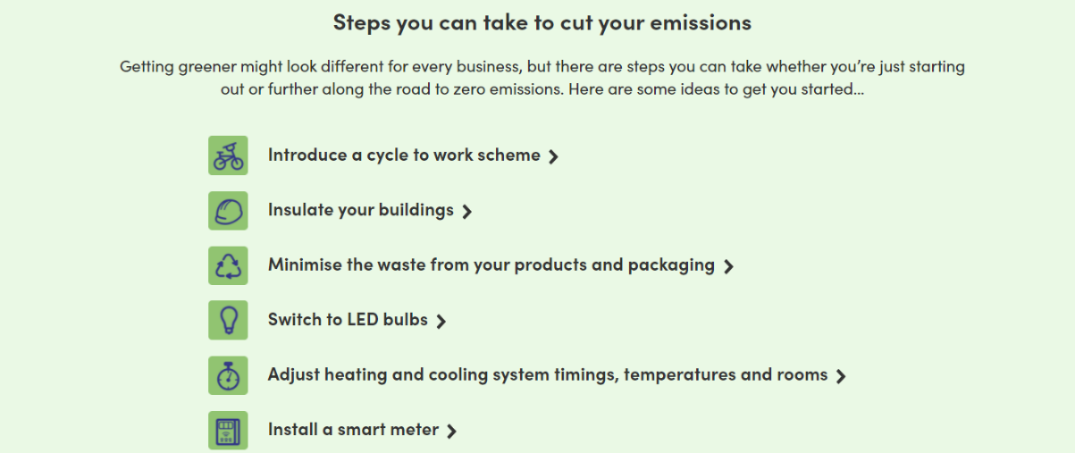
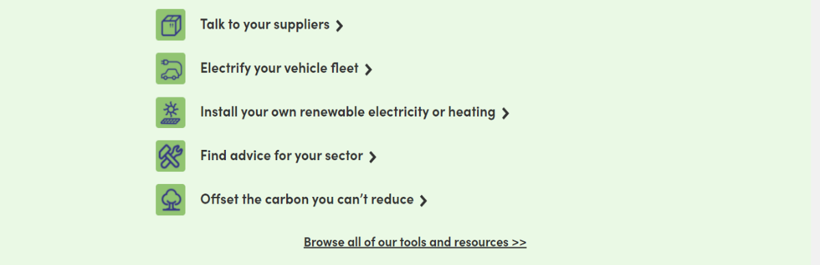
39

Slide 40
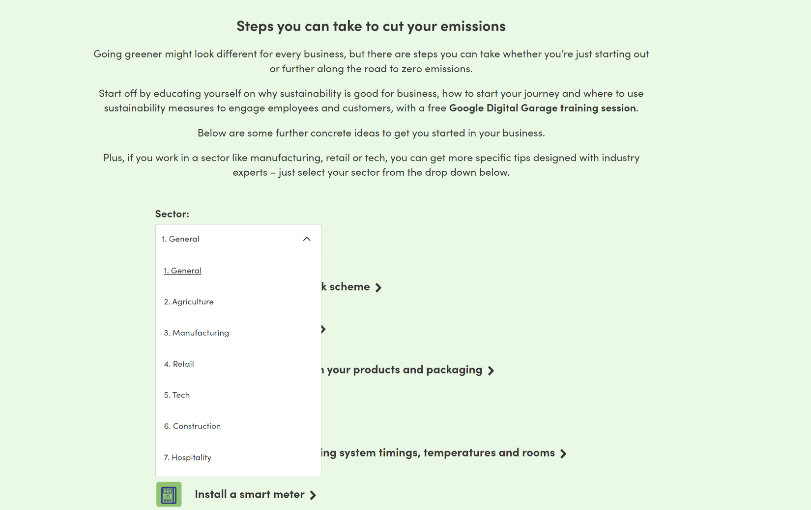

Slide 41
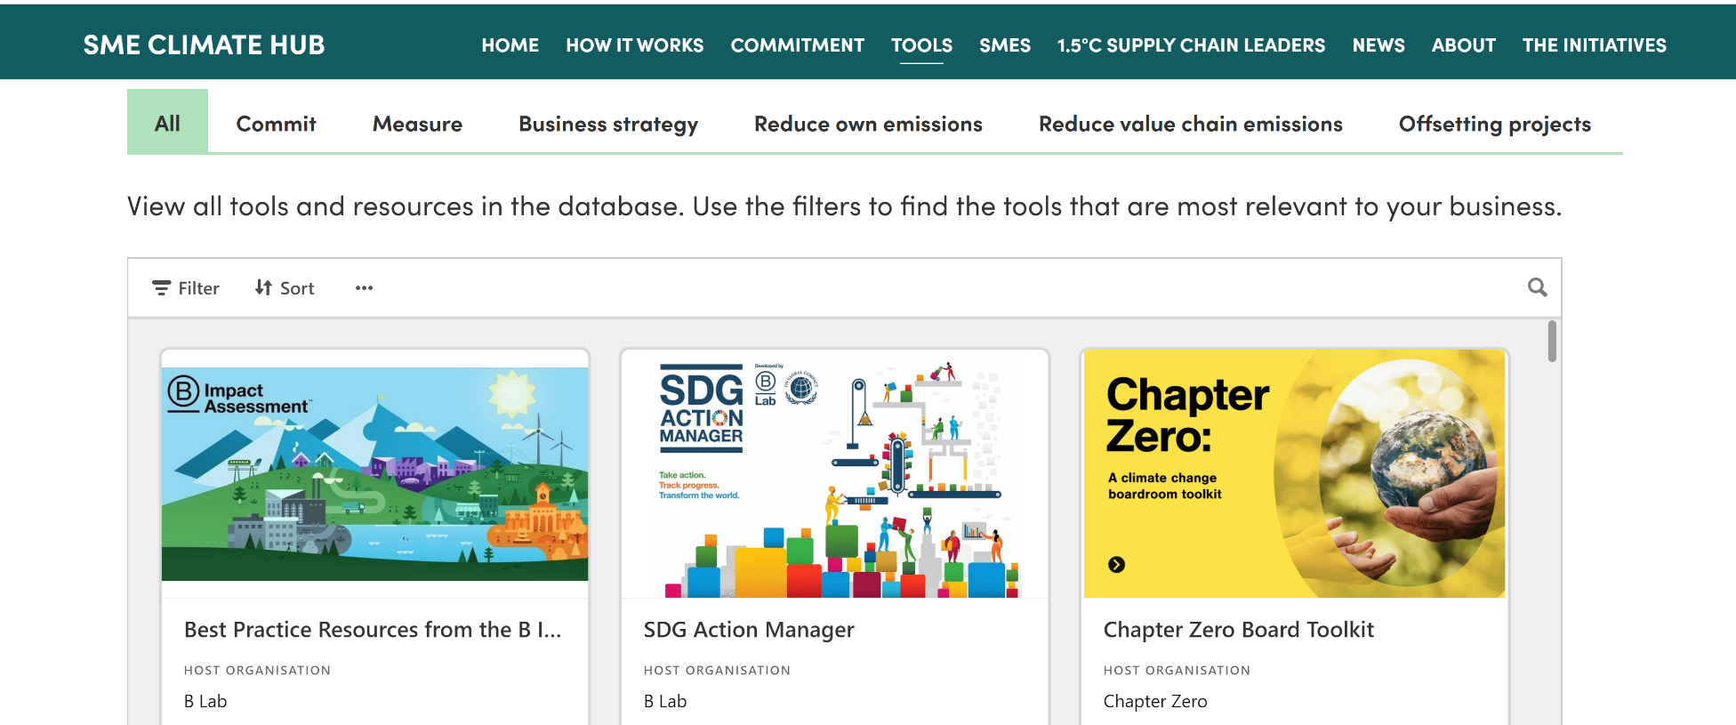

Slide 42
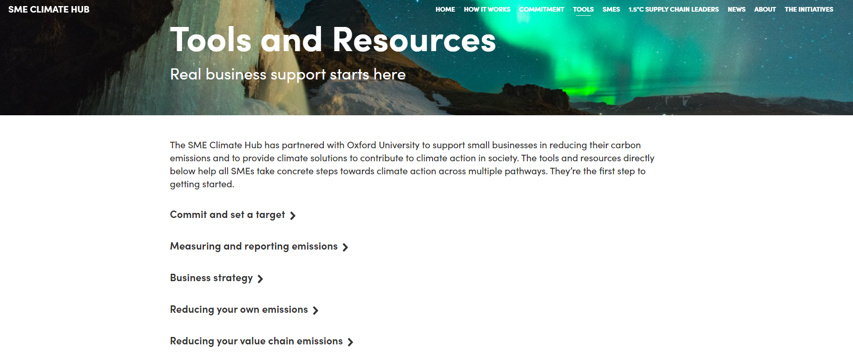
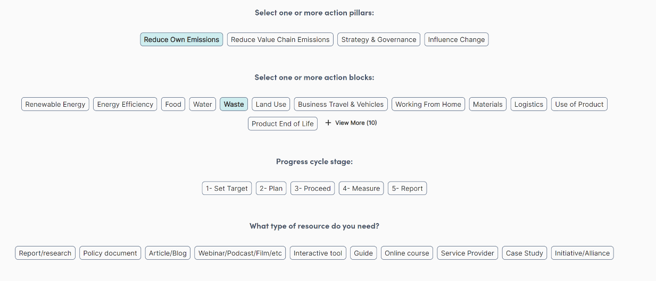

Slide 43
How you can help:
Sign up to Race to Zero! & encourage others to follow you
Promote the campaign
Share on your social media channels, newsletters
Share tools & opportunities on ongoing basis to networks
Synergise R2Z with your existing events & campaigns
Highlight best practice
Tell your story or introduce us to inspiring businesses

Slide 44
Fiona Mahon
Climate Change Manager,
Leicester City Council
©2020 Leicestershire Business Voice | www.lbv.co.uk | @LBVtweets

Slide 45


Leicestershire Business Voice meeting - Greening our Local Economy
Presentation on Leicester city council’s COP26 campaign
Fiona Mahon, Climate Change Manager fiona.mahon@leicester.gov.uk
Notes:
45

Slide 46
COP26 Goals
Secure global net zero by mid-century and keep 1.5 degrees within reach​
Accelerate phase-out of coal​
Limit deforestation​
Speed up the switch to electric vehicles​
Encourage investment in renewables ​
Adapt to protect communities and natural habitats​
Protect and restore ecosystems​
Build defences, warning systems and resilient infrastructure and agriculture ​
Mobilise finance​
Put at least $100bn into climate finance per year to secure global net zero​
Work together to deliver​
Finalise the Paris Rulebook ​
Accelerate action to tackle climate crisis through collaboration between governments, businesses and civil society​

Slide 47
LCC campaign objectives
A cohesive campaign that links our work with schools, businesses and partner organisations to CEAP delivery and adoption of SDGs
Appeal to a wide range of audiences including staff, community groups, schools and businesses
Promote council’s climate change work locally/nationally/internationally
Raise awareness of the Climate Emergency and generate climate
action on the ground
Keep simple – key focus is climate pledge campaign with clear ask ‘What will YOU as world leaders pledge to do at COP26’
Opportunity to work in partnership with others eg Leicester FoE

Slide 48
Main campaign activities & events
Great Big Green Week – held 18-26th Sept. Activities for schools were funded by the Climate Coalition and included a secondary schools conference, eco film festival, and climate march/plastic free picnic in Abbey Park
Green hearts from Leicester campaign – running from mid Sept up to COP26 fortnight (1-12 Nov). Participants include schools, universities, faith & community groups, and businesses. People are being asked to write a climate action pledge on a green paper heart and photograph these to put on social media. Green hearts posted to council by 1st Nov will be sent to Director of Comms at COP26

Slide 49

#GreenHeartsFromLeicester
I’m taking action on climate change by…
What are YOU as world leaders pledging to do at COP26?

Slide 50

#GreenHeartsFromLeicester
I’m taking action on climate change by…
What are YOU as world leaders pledging to do at COP26?

Slide 51
LCC campaign activities & events (continued)
Tree of hearts event held on 24th Sept at Abbey Park
COP26 video briefing for council and LLEP staff
Media plan for stories during COP fortnight
Green hearts display in Town Hall Square, Leicester on Sat 6th Nov (international day of action at COP26)

Slide 52
Want to get involved?
It’s easy for your business to take part. For pledge ideas and a heart template log onto https://www.leicester.gov.uk/greenhearts
THANK YOU!

Slide 53


Slide 54

What is Green BELLE?
Grants to SMEs for low carbon and energy efficient measures
European Regional Development Fund (ERDF) project
Energy Projects Team (Leicester City Council)
Phase 1 – November 2016 to December 2019
Phase 2 – January 2020 to December 2022

Slide 55


What is Green BELLE?
Grants of £1,000 - £10,000
50% ERDF grant - 50% SME match funded
Energy efficiency measures
SMEs in Leicester and Leicestershire

Slide 56

Green BELLE Aims to…
Support the local low carbon economy
Reduce annual GHG emissions
Targets
Number of enterprises receiving support – 293
Estimated annual decrease of GHG – 2,439 tCO₂e

Slide 57













Measures Supported
Energy Efficient
Machinery
Heating Controls
Wall Insulation
Energy Storage
Ceiling / Loft Insulation
Biomass Boilers
Lighting Controls
Building Management Systems
Boilers
Lighting
Heat Pumps
Solar

Slide 58

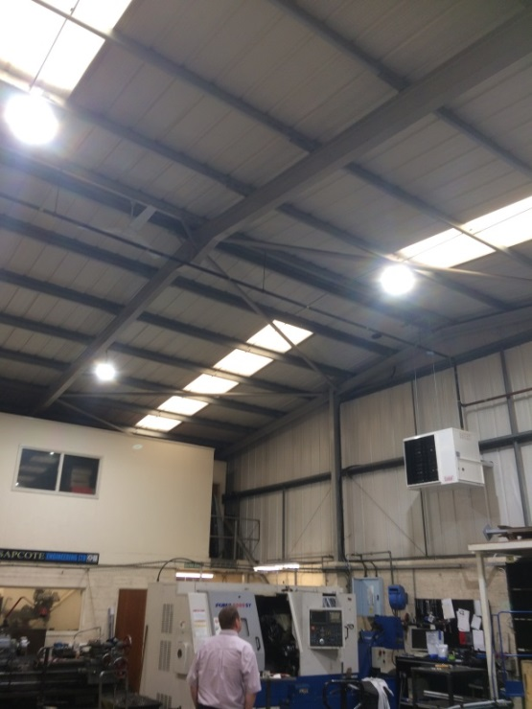

Case Study – Sapcote Engineering Limited
Engineering company - Broughton Astley
Measures applied for: LED high bay lighting, new gas blowers and destratification fans
Green BELLE grant of £6,521.78
4.3 tCO₂e and £1,600 saved annually
(53% lighting and 9% heating)

Slide 59

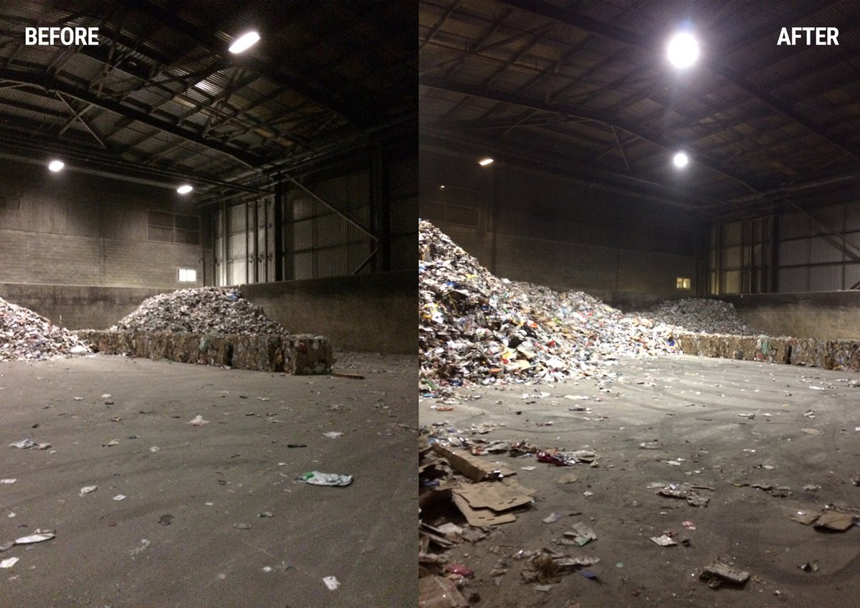
Case Study – Casepak Ltd
One of the UK’s most diverse recycling companies
Measures applied for: 196 high bay LED lights to replace 1176 5ft T12 fluorescent tubes
Green BELLE grant of £10,000
24 hour operation site
114.6 tCO₂e and £42,000 saved annually (59%)

Slide 60
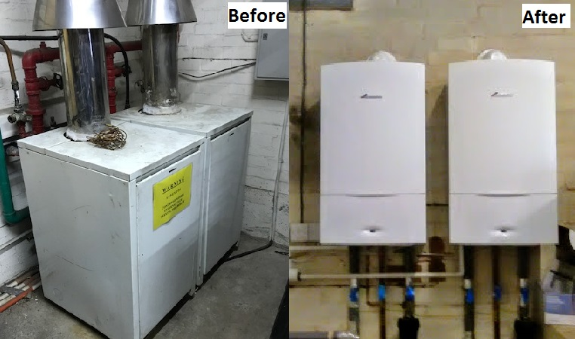
Case Study – Barkby Properties
Real estate and letting agent – office building
Measures applied for: replace two 35 year old gas boilers, with two ‘A’ rated boilers (42kW)
Green BELLE grant of £4,060
Degree day analysis applied to GHG calculations
6 tCO₂e and £1,600
saved annually (27%)

Slide 61
Phase 1 Achievements
92 SMEs awarded a Green BELLE grant
£509,302 of ERDF grant awarded
850 tCO₂e approximate total annual GHG saving
(estimated for all 92 SMEs)
Established referral mechanisms and strong relationships with other projects

Slide 62
Phase 2
January 2020 – December 2022
200 further grants to SMEs
£1.1 million of new ERDF grant funding available
1,400 tCO2e phase 2 annual GHG saving target

Slide 63
Contact Details
Rob Leeson & Anna Dias
0116 454 2700
energygrant@leicester.gov.uk
www.GreenBELLE.org.uk
@LeicesterEnergy

Slide 64
Richard Garner
Head of Partnerships,
Zellar
©2020 Leicestershire Business Voice | www.lbv.co.uk | @LBVtweets

Slide 65

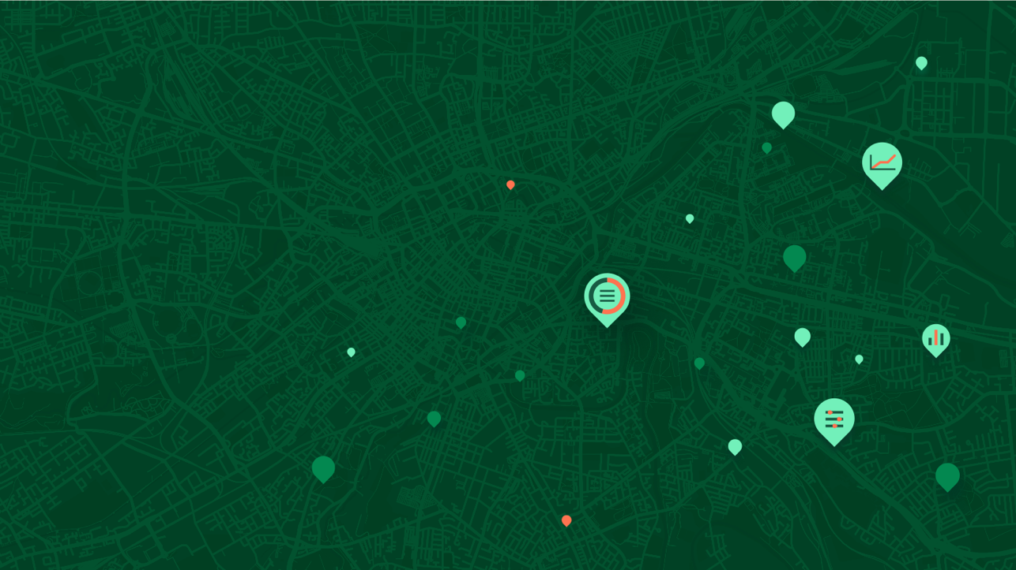


Sustainable Together
Introducing Zellar; the Sustainability platform.
Zellar Explainer Video
Company Confidential ©Zellar 2021

Slide 66





Zellar
GBSLEP
October, 2021
So, we
created Zellar
A platform that empowers employees and owners of businesses with the right tools to help them become more sustainable, responsible and competitive by 2030.
Customised roadmap
All in once place
One annual payment
How does it work?
Share the story
We've created 63 micro sector roadmaps on the platform for business owners to choose from and kick start their journey.
Each programme is unique, providing benchmarks, insights, behaviours, investments and local offsets.
Business owners can access all of the key components that make up their sustainability programme in one place.
Allowing a single view and easy access to the information needed to create the lowest cost and most efficient path to
Net Zero.
Zellar's 'Sustainability-as-a- Service' pricing starts at £125 per annum for a micro business.
We're making sustainability accessible and affordable for every business.
A simple sign up process, leads business owners into their step-by-step sustainability journey where they can take action in their own time and at their own pace.
Sustainability can be a daunting subject. We’re making sustainability simple.
Every step of their journey to Net Zero is captured, packaged and made available for sharing via their Zellar profile, our directory and their social media networks of choice.
Company Confidential ©Zellar 2021

Slide 67
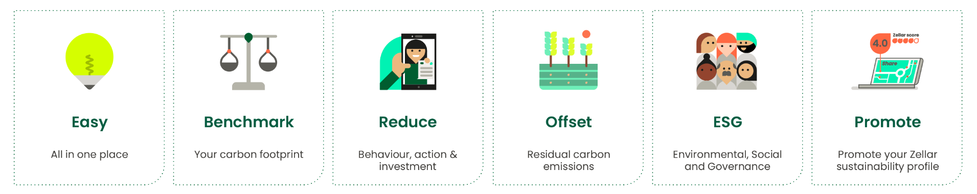
Zellar Sustainability Platform
Launch Leicester
Zellar’s Sustainability Platform
99.9% of Businesses are SME’s - 60% UK workforce
78% Don’t know what to do
UK Net Zero plan -> Enable SME’s -> Business differentiator
Annual payment
£125 - £600/year
Transparent / peer to peer
64 Sectors
Benchmarked
Each sector
Behavioral actions
Green Tech/Energy
Local, UK
Trusted
International
Engage your community
Promote your business
Notes:
A country wide Net Zero strategy must include SME’s
Zellar Strategy
1. Businesses are not the same Customised proposition
2. Everything in one place
3. Benchmark – what does good look like in my sector?
4. Action plan – own time, pace and language
5. Transparency – trust in everything they buy, see and do
6. Share – share the journey and engage all stakeholders
Built a business model around that;
Annual subscription
Worlds first peer to peer green marketplace

Slide 68
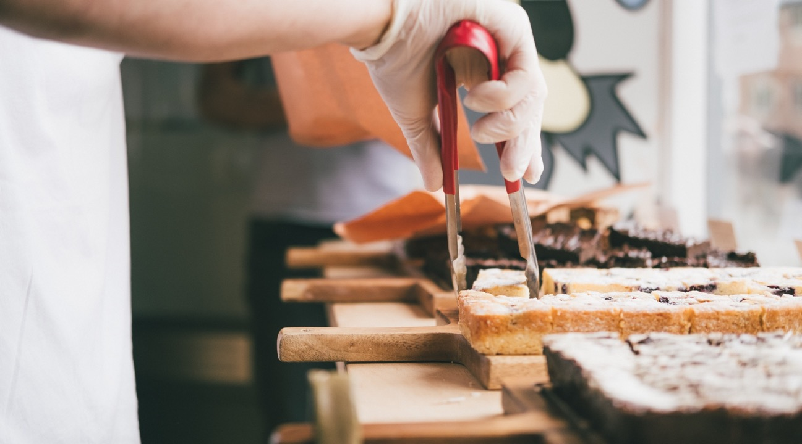

Zellar
Our story
April 2021
Why do businesses
choose Zellar?
We make sustainability simple
We accelerate their sustainability goals
We save them lots of money
We make their business competitive
We enhance their reputation
We help create their legacy
Company Confidential ©Zellar 2021

Slide 69

Thank you
Visit Zellar.com
Notes:
Talk about it, communicate.

Slide 70
Research & Innovation Goldmines on our Doorstep
Questions
©2020 Leicestershire Business Voice | www.lbv.co.uk | @LBVtweets

Slide 71
Our next events
18 November - Members Dinner at The Belmont Hotel
8 December - Christmas Social at Rutland & Derby from 5-8pm
Details www.lbv.co.uk/events
Sign up to our mailing list to learn about forthcoming LBV events and webinars
©2020 Leicestershire Business Voice | www.lbv.co.uk | @LBVtweets

Slide 72
Lend us your voice…
Presentations and useful links will be available to view at www.lbv.co.uk/events
If you enjoyed today’s event, and would like to find out about becoming a Leicestershire Business Voice member, please visit our website at www.lbv.co.uk
By joining LBV, you can:
Help businesses thrive
Voice your opinions with local and regional decision makers
Influence policy affecting our economy
Sign up to our mailing list to learn about forthcoming LBV webinars
©2020 Leicestershire Business Voice | www.lbv.co.uk | @LBVtweets

