Slide 1
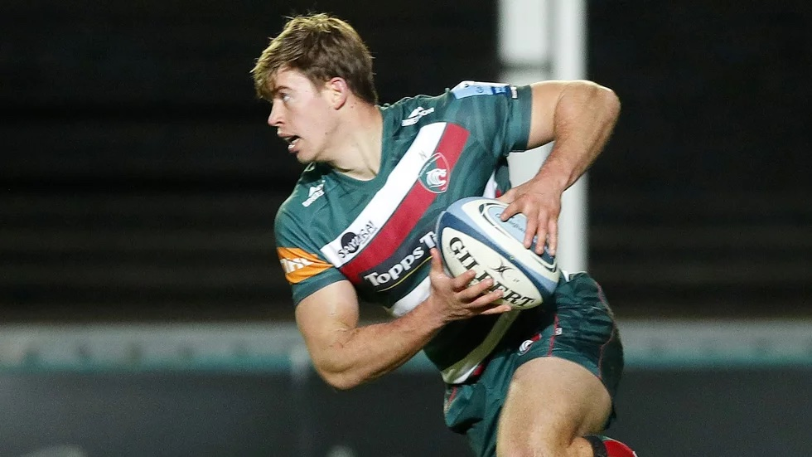
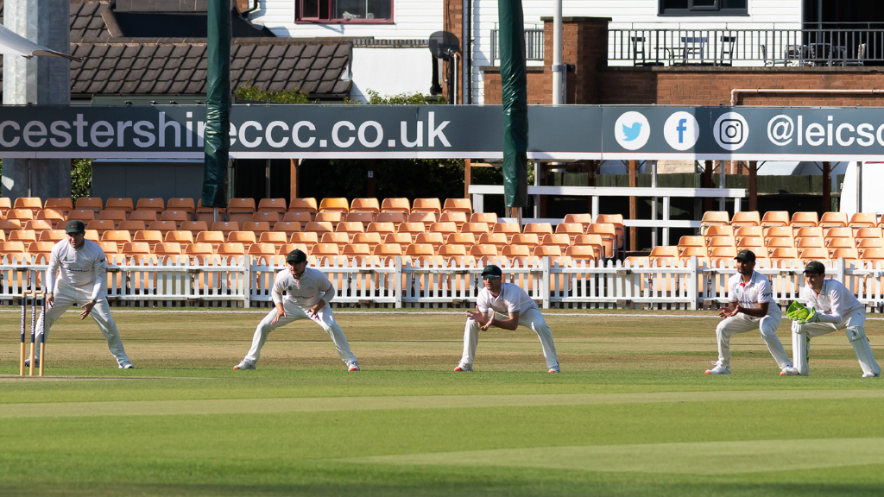
What are the challenges and opportunities facing the manufacturing sector in 2021 and beyond?
The Business of Sport
©2021 Leicestershire Business Voice | www.lbv.co.uk | @/LBVtweets

Slide 2
Welcome & Introduction Robin Pointon – Chair of LBV, Go Travel Solutions
©2020 Leicestershire Business Voice | www.lbv.co.uk | @LBVtweets

Slide 3
The proposed (and aborted) European Super League in football shows that sporting businesses are looking for new ways to create bigger income streams. Does that plan have any merit from a business or sporting perspective?
a) Yes for business
b) Yes for sport
c) Yes for both
c) Neither
©2020 Leicestershire Business Voice | www.lbv.co.uk | @LBVtweets

Slide 4
LEICESTER TIGERS
THE BUSINESS OF SPORT
CLUB FIRST | RESILIENT | CREATIVE | PASSIONATE
CONFIDENTIAL: THIS DOCUMENT CONTAINS SENSITIVE INFORMATION THAT MUST NOT BE SHARED WITHOUT WRITTEN PERMISSION.

Slide 5
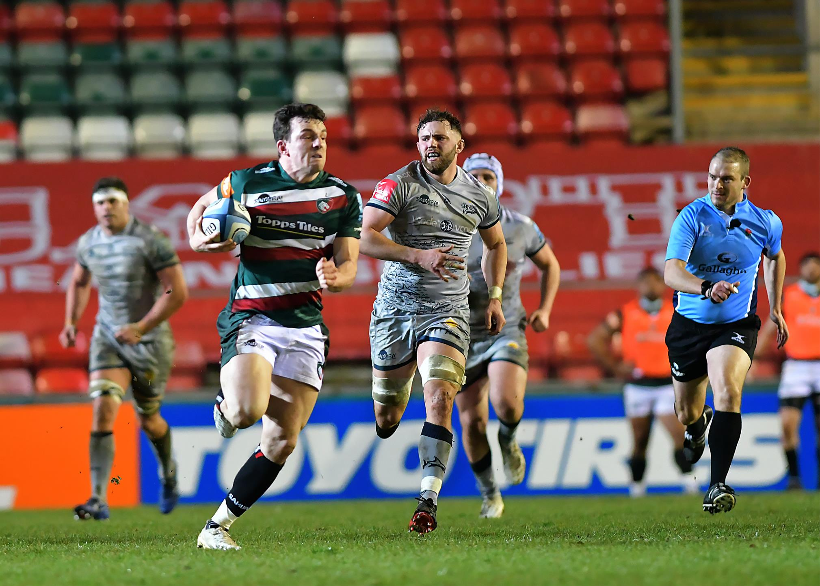
HOW DOES OUR BUSINESS DIFFER FROM YOURS – THE KEY FUNDAMENTALS
OUR PLACE OF WORK IS ONLY USED BETWEEN 16 – 19 DAYS PER YEAR FOR OUR CORE BUSINESS
98.96% OF OUR STAFF ARE EMPLOYED BECAUSE OF THESE 16 – 19 DAYS
90% OF OUR TURNOVER IS GENERATED BECAUSE OF THESE 16 – 19 DAYS
OUR BUSINESS HAS TIGHT RESTRICTIONS ON HOW MUCH WE ARE ALLOWED TO SPEND ON DEVELOPING OUR CORE PRODUCT – AND STRINGENT PENALTIES IF BREACHED
OUR BUSINESS IS WIDELY DIVERSE: SPORT, RETAIL, EDUCATION, HEALTH AND WELLBEING, NUTRITION, MEDICAL, HOSPITALITY, WEDDINGS, FUNERALS, COMMUNITY, SCHOOLING, MEDIA AND PRESS
OUR DECISIONS AND RESULTS CAN BE – AND ARE - JUDGED IN REAL TIME BY OVER 568 MILLION HOUSEHOLDS

Slide 6
YOU CAN PLEASE SOME OF THE PEOPLE SOME OF THE TIME………….
820,000
VIDEO VIEWS PER MONTH
568M
8.9M
GLOBAL HOUSEHOLDS VIEWING FIGURES
UK VIEWING FIGURES
158,000
REGISTERED SUPPORTER BASE
480,000
SOCIAL SUPPORTERS

Slide 7
THE IMPACT OF THE PANDEMIC
MARCH 2020 – GATES WERE CLOSED TO SUPPORTERS
LOST INCOME OF £1M PER MONTH MADE UP OF MATCHDAY REVENUE, CENTRAL DISTRIBUTIONS FROM THE RFU AND PRL
IMMEDIATE ACTION WAS REQUIRED TO IDENTIFY AND IMPLEMENT COST SAVINGS – INCLUDING REDUNDANCIES, SALARY REDUCTIONS, CLOSURE OF FACILITIES
SINCE RETURN TO PLAY BEHIND CLOSED DOORS IN AUGUST £248,000 SPENT ON RANDOX TESTING TO FACILITATE SAFE TRAINING
AN OPPORTUNITY TO REVIEW AND RESET
A STRATEGIC, FOCUSED BUSINESS WITH CLEARLY ARTICULATED GOALS OVER A THREE YEAR ROLLING PLAN
AN EXCITING FUTURE

Slide 8
BRAND LEICESTER
25% OF OUR SUPPORTERS LIVE OVER 1 HOUR AWAY FROM THE CITY RESULTING IN THEM SPENDING TIME AND MONEY IN THE CITY ON MATCH DAY
JOHN LEWIS REPORT SHOWED AN INCREASE IN STORE SPEND BY 15% ON A MATCHDAY WITH 78% OF OUR SUPPORTERS WHO TRAVEL BY CAR, PARKING IN THEIR MSCP
ERNST AND YOUNG REPORT AFTER THE RWC2015 ESTIMATED THE INCREMENTAL SPEND OF RUGBY VISITORS TO LEICESTER WAS BETWEEN £60 - £80PP.
LED BY LCFC, YOUR SPORTING TEAMS HAVE TRULY PUT OUR CITY ON THE GLOBAL MAP.
ASK ANY TAXI DRIVER OR GO INTO ANY BAR ANYWHERE IN THE WORLD WEARING ONE OF YOUR COUNTIES SPORTING BADGES AND THEY’LL KNOW LEICESTER

Slide 9
THANK YOU LEICESTER
THE SUPPORT AND ENCOURAGEMENT WE HAVE RECEIVED AS A CLUB FROM OUR COMMUNITY HAS BEEN TRULY HUMBLING. AS HAS THE SUPPORT I HAVE PERSONALLY RECEIVED.
PRIOR TO THE PANDEMIC AND WITH UTMOST HONESTY, OUR CULTURE WAS ERODED AND WE HAD LOST OUR WAY.
NOW - WITHOUT DOUBT- WE HAVE SURVIVED THE WORST TIME IN OUR HISTORY AND WILL COME BACK STRONGER THAN EVER.
THE FUTURE FOR YOUR RUGBY CLUB IS BRIGHT.

Slide 10
When would you feel comfortable attending a stadium to watch a match at full capacity?
a) Immediately
b) In June following change of Government regulations
c) Later this year
d) In 2022
©2020 Leicestershire Business Voice | www.lbv.co.uk | @LBVtweets

Slide 11
Sean Jarvis CEO – Leicestershire CCC
#runningfoxes | #foxesfamily | #ANewBreed

Slide 12
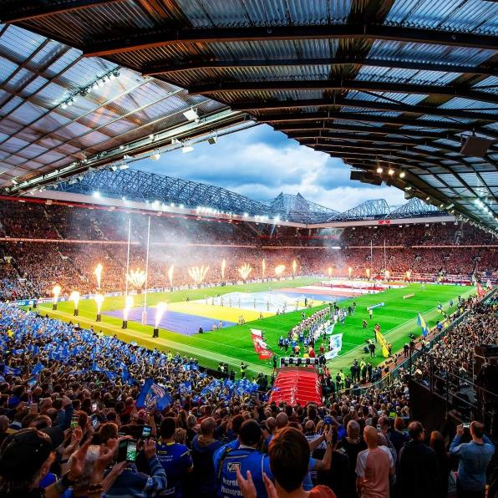
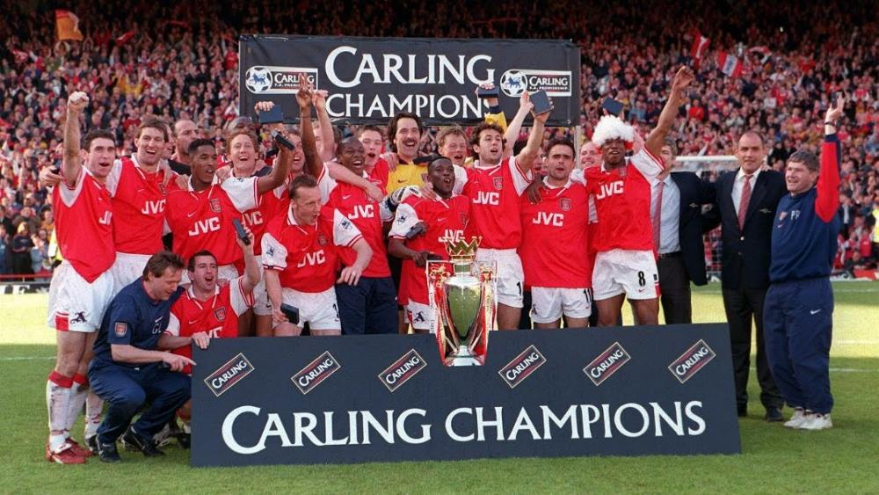

Slide 13
HOSPITALITY VENUE
MEDIA COMPANY
CHARITY
CRICKET CLUB
BUSINESS NETWORK
CONCERT VENUE
DATA COMPANY

Slide 14
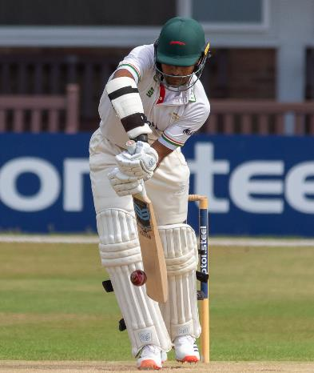
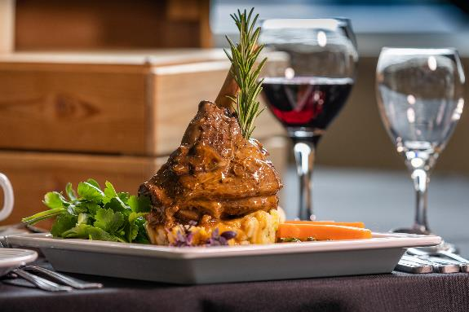
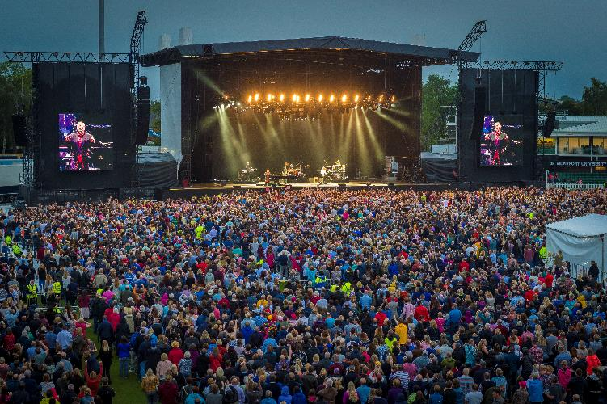
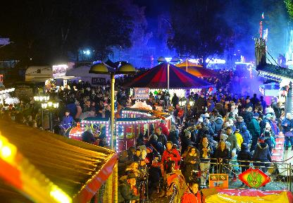
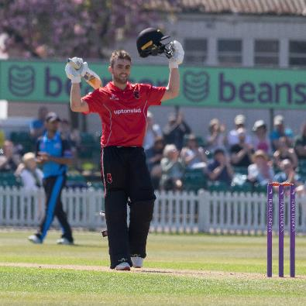
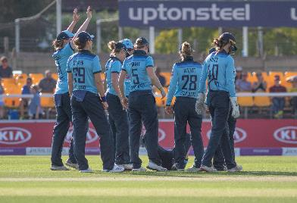

Slide 15
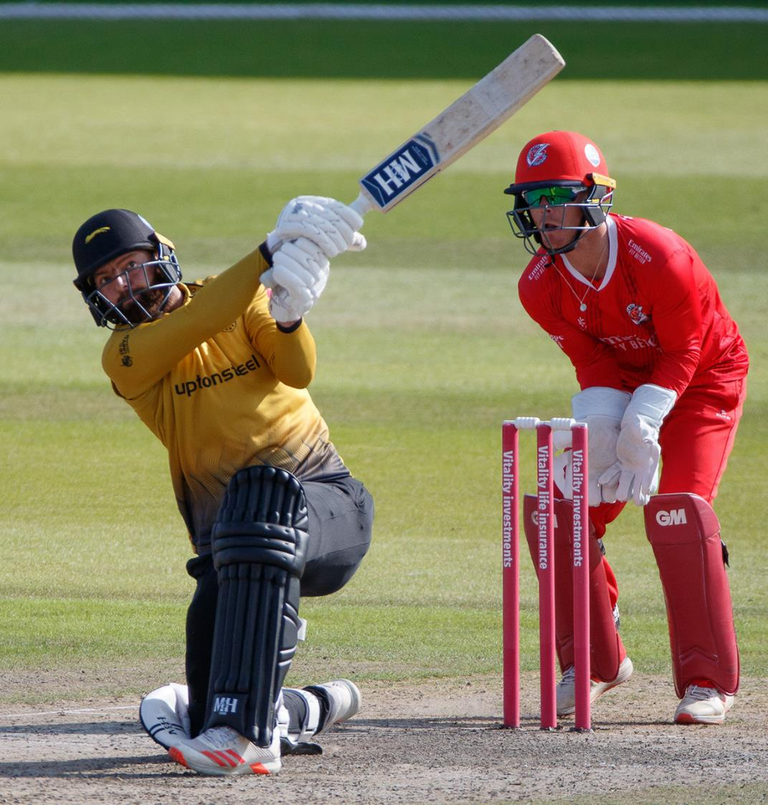
The Batting Order
Culture/Strategy/Vision/Positioning
Ecosystem
Squad 21/22
Pathway
Commercial Relationships
Community Link
Bums on Seats
Brand Development
Ground Development
Governance
Foundation

Slide 16
£1.5m and counting…..

Slide 17
The Importance of Cricket to Leicestershire
Profile……Cricket broadcast to 2.5 Billion
Civic Pride and Heritage (11 Trophies and a World Record)
On the Map… one of 18 FCC’s
Contribution to England… Broad, Agnew, Gower, Defrietas etc
International Connections…. Kumble, Simmons, Afridi, Roberts, Harris
Community…. Giving back (our Foundation)
Our Children…
City of Sport

Slide 19
The Business of Sport webinar
Any questions?
©2020 Leicestershire Business Voice | www.lbv.co.uk | @LBVtweets

Slide 20
LBV update
Robin Pointon and Mukesh Bulsara
©2020 Leicestershire Business Voice | www.lbv.co.uk | @LBVtweets

Slide 21
Lend us your voice…
Presentations and useful links will be available to view at www.lbv.co.uk/events
If you enjoyed today’s event, and would like to find out about becoming a Leicestershire Business Voice member, please visit our website at www.lbv.co.uk
By joining LBV, you can:
Help businesses thrive
Voice your opinions with local and regional decision makers
Influence policy affecting our economy
Sign up to our mailing list to learn about forthcoming LBV webinars
©2020 Leicestershire Business Voice | www.lbv.co.uk | @LBVtweets

