Slide 1
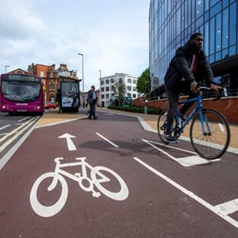
Climate Emergency
A business challenge or opportunity?
©2020 Leicestershire Business Voice | www.lbv.co.uk | @/LBVtweets

Slide 2
Climate Emergency – a business challenge or opportunity?
Host: Neil McGhee, LBV board member
Today’s speakers:
Dr Shamir Ghumra – BREEAM Director at BRE
Gavin Fletcher – Midlands Energy Hub
Anna Dodd - Energy and Sustainability Manager, Leicester City Council
Marina Sykes - Octopus Energy
©2020 Leicestershire Business Voice | www.lbv.co.uk | @/LBVtweets

Slide 3
Poll question 1
Has Covid-19 changed your perspective on the Climate Emergency?
©2020 Leicestershire Business Voice | www.lbv.co.uk | @/LBVtweets

Slide 4
Dr Shamir Ghumra BREEAM Director at BRE
©2020 Leicestershire Business Voice | www.lbv.co.uk | @/LBVtweets

Slide 5
Climate Emergency
Dr Shamir Ghumra, 8th October 2020
A business challenge or opportunity?

Slide 6
Climate Emergency
What is a climate emergency and what does it mean for business?
“a situation in which urgent action is required to reduce or halt climate change and avoid potentially irreversible environmental damage resulting from it”
International agreements, e.g. the Paris Agreement, have driven governments to enforce national targets to address this
UK 'net-zero' target by 2050
Business' have a role to play to respond to the climate emergency and help meet these targets

Slide 7
Climate Emergency: Business Challenges
Financial risks: Lack of investment in non-compliant business'​
Physical risks to business operations:
e.g. Flooding, energy shortage
Policy risks: Tighter regulation; Cap on resource use; Carbon tax
Legal risks: Climate-related litigation​
Reputational risks: Companies who do not act to reduce their contribution to global warming will take a big hit
Market/technology risks: New low-carbon technologies disrupt the economy, decrease demand for existing products/services
Existential risks: No planet & resources, no business

Slide 8
Climate Emergency: Business Opportunities
Mitigation and adaptation measures drive growth and innovation
Mitigation measures:
ESG performance, data & disclosure (TFCD)
Green finance/investment opportunities
Alternative low-carbon technologies/services
Production efficiencies
Sustainable transport & buildings
Adaptation measures:
Resilient infrastructure & buildings
Habitat protection

Slide 9
Responding to the Climate Emergency AND Covid-19?
These opportunities can create...
New jobs - UK could create almost 700,000 new green jobs by 2030
New business models
The Green Recovery
To recover from the economic impacts of Covid-19...
Job losses & recession - UK lost 700,000 + jobs during covid-19
Business failures

Slide 11
Poll question 2
Has the importance of the Climate Emergency to your business changed over the last 5 years?
©2020 Leicestershire Business Voice | www.lbv.co.uk | @/LBVtweets

Slide 12
Gavin Fletcher Midlands Energy Hub
©2020 Leicestershire Business Voice | www.lbv.co.uk | @/LBVtweets

Slide 13
Midlands Energy Hub and the net Zero economy
Gavin Fletcher –
Regional Senior Energy Projects Officer
Gavin.fletcher@nottinghamcity.gov.uk
07516110212

Slide 14
Energy Services & Midlands Energy Hub supports
organisations to switch to renewable and low carbon energy solutions

Slide 15
LLEP and zero carbon
Funded projects
Zero carbon running through Local Industrial Strategy and Recovery Strategy
Linking to wider funding through MEH
Understanding the local Low Carbon Goods and Services Sector and business interests
Energy Services & Midlands Energy Hub supports organisations to switch to renewable and low carbon energy solutions
customerservices@energyservices-ncc.gov.uk | 0115 955 6677 | www.energyservices-ncc.co.uk
Energy Services & Midlands Energy Hub supports
organisations to switch to renewable and low carbon energy solutions

Slide 16
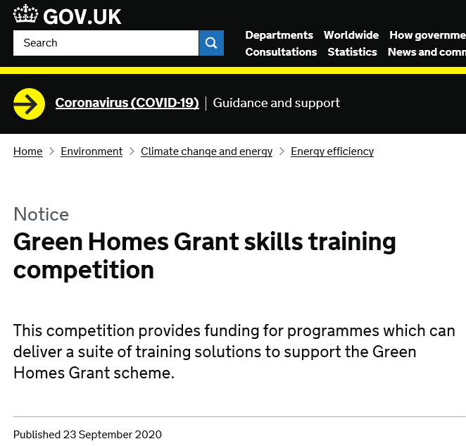
Business opportunities
Energy Services & Midlands Energy Hub supports
organisations to switch to renewable and low carbon energy solutions

Slide 17
Resources
Funding, practical support and on-line resources -
Leicester University – particularly the Innovation Hub https://le.ac.uk/enterprise/development
Green Belle – grants of up to £7k for energy efficiency measures https://www.greenbelle.org.uk/
Examples of work elsewhere https://www.lowcarbonbusiness.net/
Carbon Trust - https://www.carbontrust.com/
LLEP Business Gateway - https://bizgateway.org.uk/
Sector specific support e.g. Food and Drink Forum - https://www.foodanddrinkforum.co.uk/public/
Energy Services & Midlands Energy Hub supports organisations to switch to renewable and low carbon energy solutions
customerservices@energyservices-ncc.gov.uk | 0115 955 6677 | www.energyservices-ncc.co.uk
Energy Services & Midlands Energy Hub supports
organisations to switch to renewable and low carbon energy solutions

Slide 18
Poll question 3
Could any of your current products or services be seen as improving the carbon picture of Leicester?
©2020 Leicestershire Business Voice | www.lbv.co.uk | @/LBVtweets

Slide 19
Anna Dodd Energy and Sustainability Manager Leicester City Council
©2020 Leicestershire Business Voice | www.lbv.co.uk | @/LBVtweets

Slide 20
Leicester’s Climate Emergency Strategy and Action Plan

Slide 21
Steps so far
Declaration
Draft proposals
Climate Emergency Conversation
Draft Strategy and Plan
Implementation and widening involvement
Notes:
Council declared climate emergency 1st February 2019 – one of the first councils to do so.
Draft proposals: how will Leicester need to change? What action could the council and others take?
Climate Emergency Conversation – overwhelming mandate for action – council needs to lead by example
Concerns about impact of change on people – reinforcing need for a fair and just transition.
Strategy and Action Plan – expert comment welcome. Focus on where the council can be most effective.
August launch.

Slide 22
Areas for action
At home
Travel and transport
Consumer choices
Waste
At work
Land use, green space and development
Notes:
We have put consumer choices and waste as one section on consultation as reducing our waste through the choices we make is top of the hierarchy

Slide 24
What is Green BELLE?
Grants to SMEs for low carbon and energy efficient measures
European Regional Development Fund (ERDF) project
Energy Projects Team (Leicester City Council)
Phase 1 – November 2016 to December 2019 Phase 2 – January 2020 to December 2022

Slide 25
What is Green BELLE?
Grants of £1,000 - £7,000
50% ERDF grant - 50% SME match funded
Energy efficiency measures
SMEs in Leicester and Leicestershire

Slide 26
Green BELLE Aims to…
Support the local low carbon economy
Reduce annual GHG emissions
Targets
Number of enterprises receiving support – 293
Estimated annual decrease of GHG – 2,439 tCO₂e

Slide 27
Measures Supported
Energy Efficient Machinery
Heating Controls
Wall Insulation
Energy Storage
Ceiling / Loft Insulation
Biomass Boilers
Lighting Controls
Building Management Systems
Boilers
Lighting
Heat Pumps
Solar

Slide 28
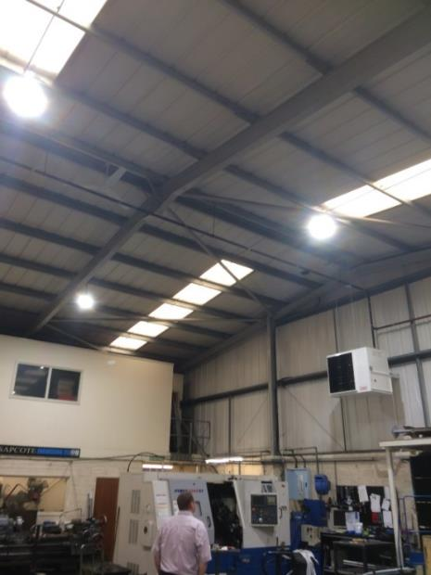
Case Study – Sapcote Engineering Limited
Engineering company - Broughton Astley
Measures applied for: LED high bay lighting, new gas blowers and destratification fans
Green BELLE grant of £6,521.78
Savings of 53% lighting & 9% heating
4.3 tCO₂e saved annually

Slide 29
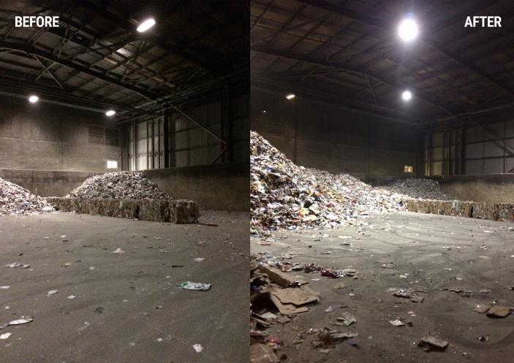
Case Study – Casepak Ltd
One of the UK’s most diverse recycling companies
Measures applied for: 196 high bay LED lights to replace 1176 5ft T12 fluorescent tubes
Green BELLE grant of £10,000
24 hour operation site
114.6 tCO₂e saved annually (59%)

Slide 30
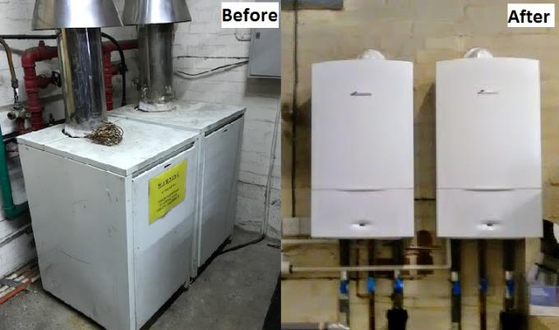
Case Study – Barkby Properties
Real estate and letting agent – office building
Measures applied for: replace two 35 year old gas boilers, with two ‘A’ rated boilers (42kW)
Green BELLE grant of £4,060
Degree day analysis applied to GHG calculations
6 tCO₂e saved annually (27%)

Slide 31
Phase 1 Achievements
92 SMEs awarded a Green BELLE grant
£509,302 of ERDF grant awarded
1,000 tCO₂e approximate total annual GHG saving (estimated for all 92 SMEs)
Established referral mechanisms and strong relationships with other projects

Slide 32
Phase 2
January 2020 – December 2022
200 further grants to SMEs
£1.1 million of new ERDF grant funding available
1,400 tCO2e phase 2 annual GHG saving target

Slide 33
Contact Details
Rob Leeson & Anna Dias
0116 454 2700
energygrant@leicester.gov.uk
www.GreenBELLE.org.uk
@LeicesterEnergy

Slide 34
Marina Sykes Octopus Energy
©2020 Leicestershire Business Voice | www.lbv.co.uk | @/LBVtweets

Slide 35
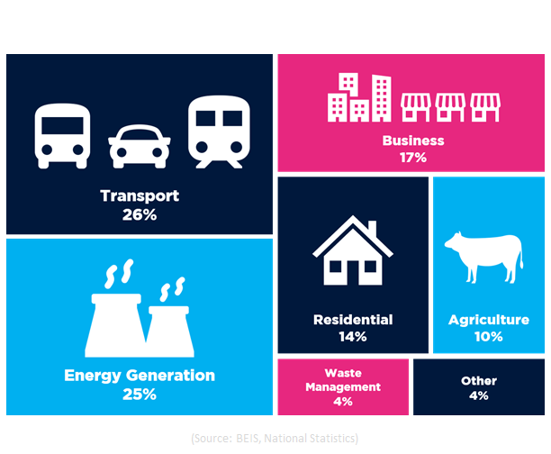
Octopus Energy for Business
Using technology to
transform customer experience
and make the green revolution
more affordable
Supply 100% renewable energy to
1.5m domestic customers &
almost 20,000 businesses in the UK
UK Greenhouse Emissions:

Slide 36
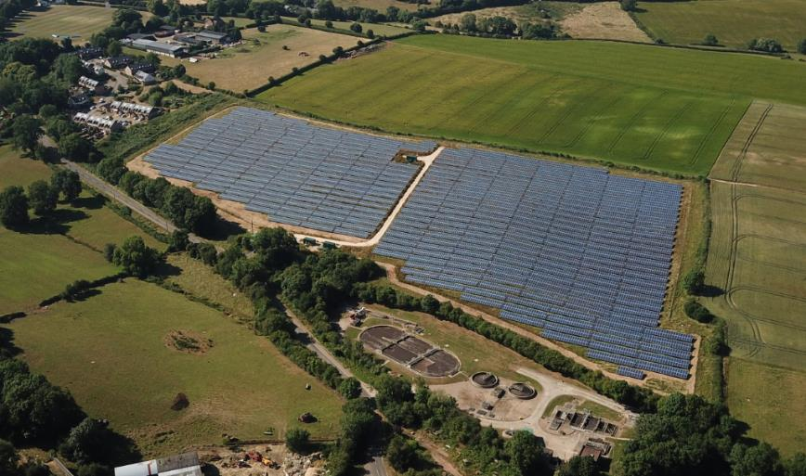
Leicester Business Power
Tackling disengaged businesses with Leicester Business Power
Supporting local power and
helping local communities take charge of their environment

Slide 37
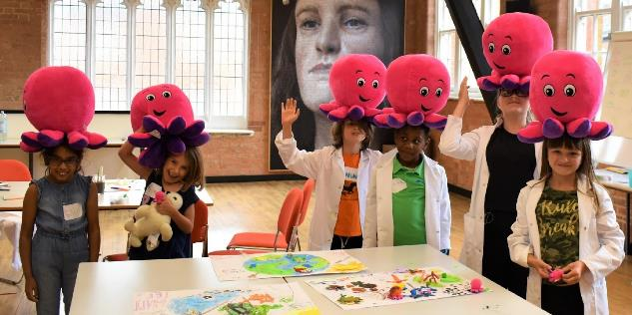
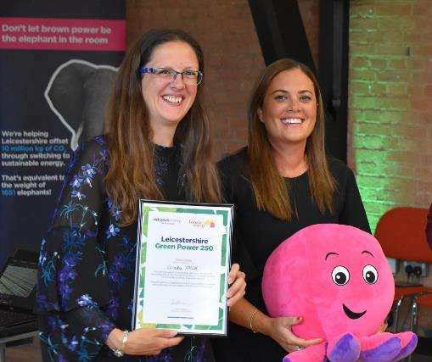
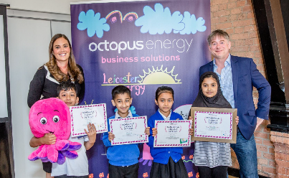
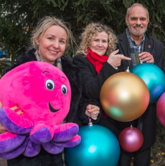
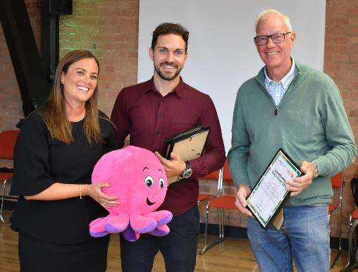
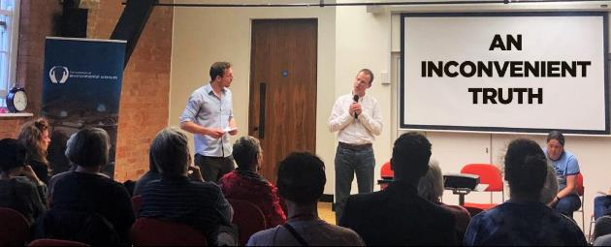
Leicester Business Power

Slide 38
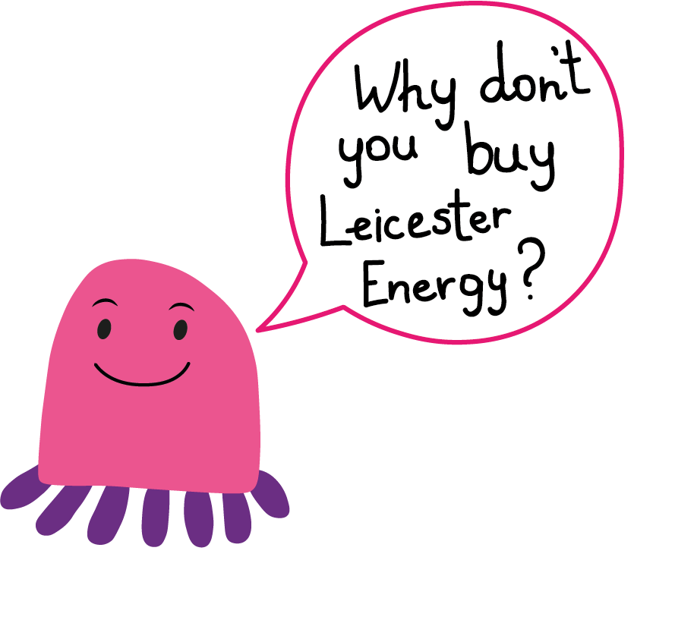
Leicester Business Power
A network of businesses passionate about creating a greener Leicester
Tackling climate change, educating the younger generation and reforesting the community
An energy supplier that is dedicated to changing the world for the better

Slide 39
Panel Q&A
©2020 Leicestershire Business Voice | www.lbv.co.uk | @/LBVtweets

Slide 40
Lend us your voice…
Presentations and useful links will be available to view at www.lbv.co.uk/events
If you enjoyed today’s event, and would like to find out about becoming a Leicestershire Business Voice member, please visit our website at www.lbv.co.uk
By joining LBV, you can:
Help businesses thrive
Voice your opinions with local & regional decision makers
Influence policy affecting our economy
Sign up to our mailing list to learn about our next LBV webinar.
©2020 Leicestershire Business Voice | www.lbv.co.uk | @/LBVtweets

